Slide 1


ATUL MEMORIAL HIGH SCHOOL, JHARSA
PRESENTS

Slide 2
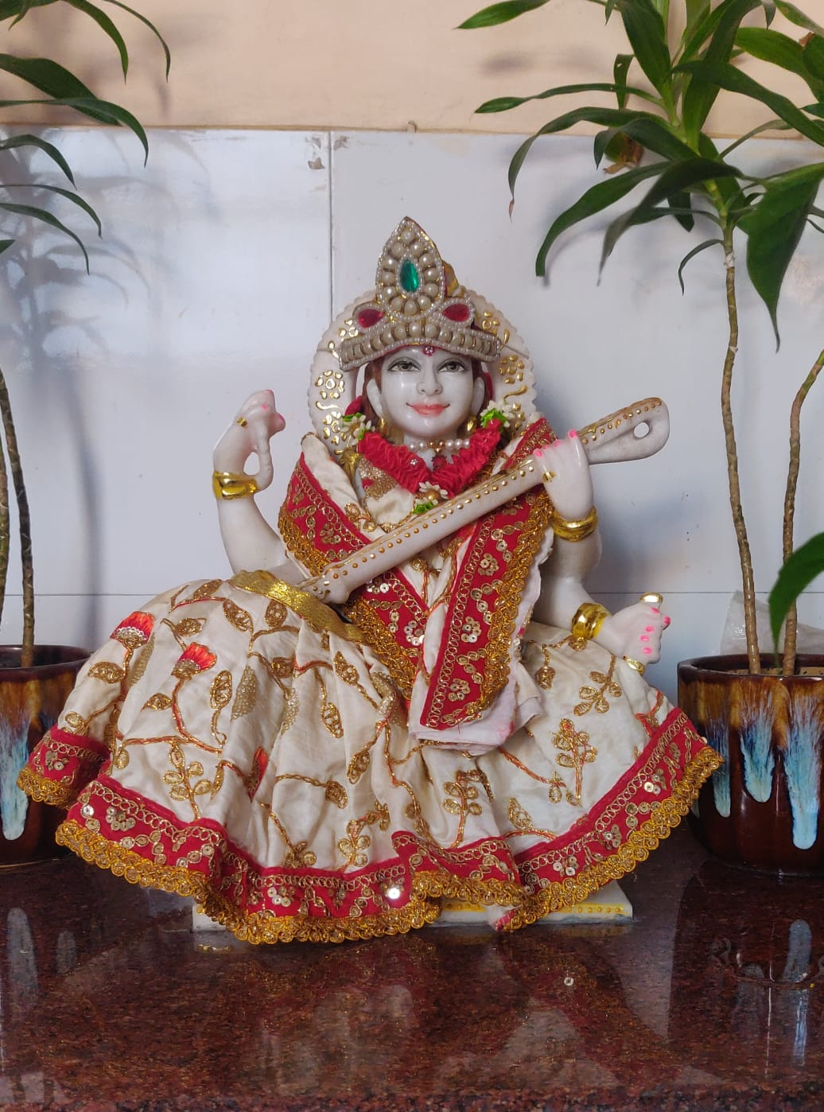

Slide 3
FOUNDATION DAY
FOUNDATION DAY
ATUL MEMORIAL HIGH SCHOOL
26 FEBRUARY, 1993

Slide 4
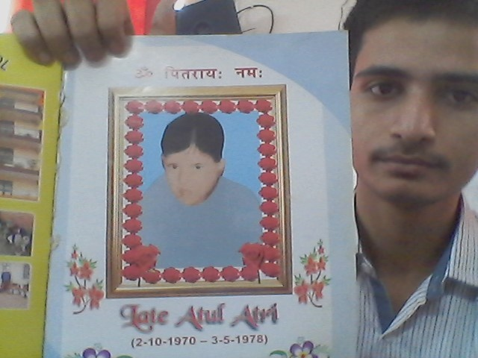
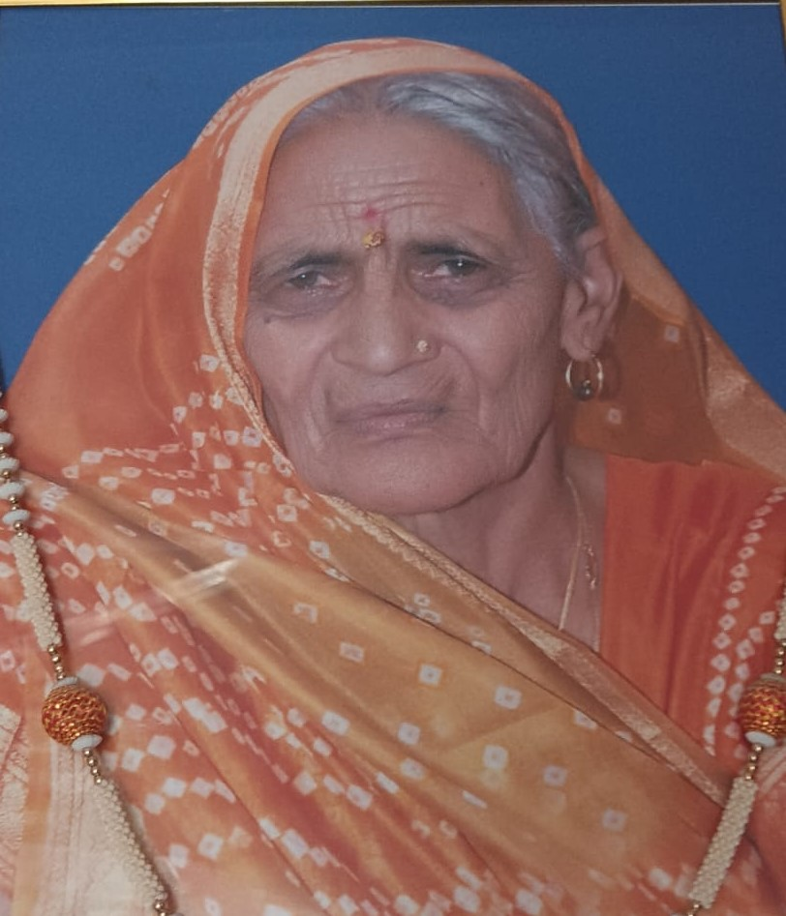
IN THE MEMORY OF :-
LT. SH. ATUL ATRI
LT. SMT. LAXMI DEVI
(02-10-1970 to 03-05-1978)
(01-08-1942 to 24-01-2021)

Slide 5
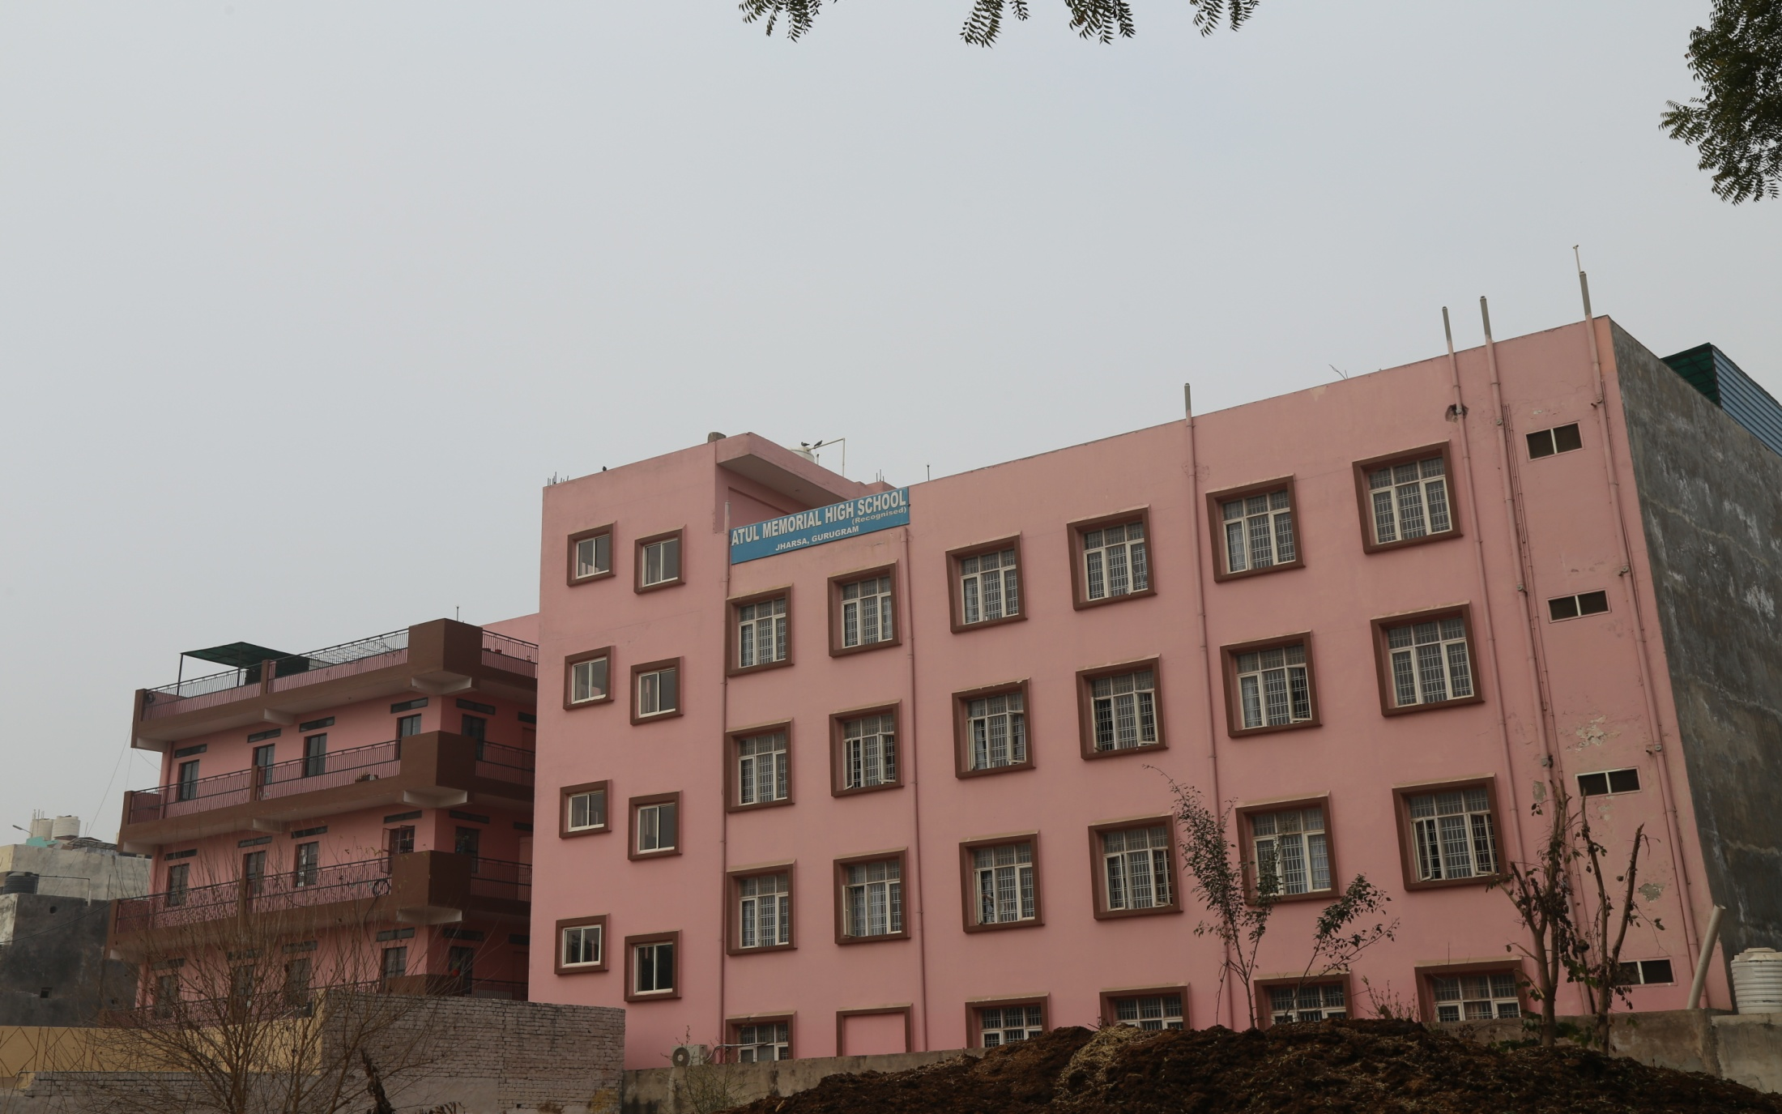
OUR SCHOOL

Slide 6
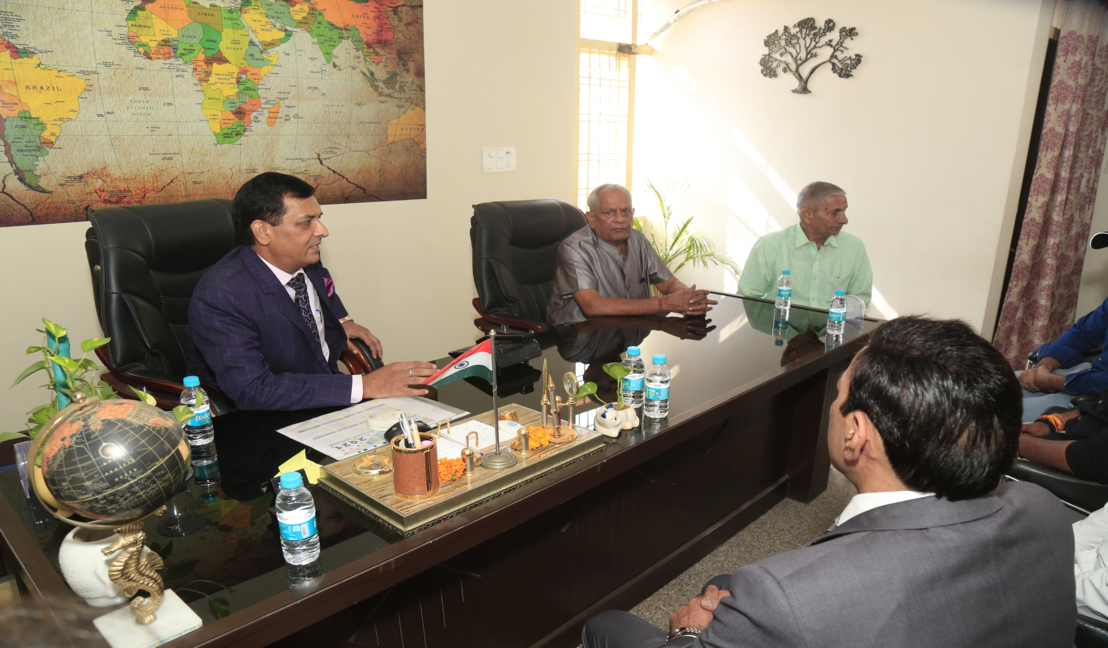
CHAIRMAN
SH. NANAK CHAND SHARMA
FOUNDER OF ATUL MEMORIAL HIGH SCHOOL

Slide 7
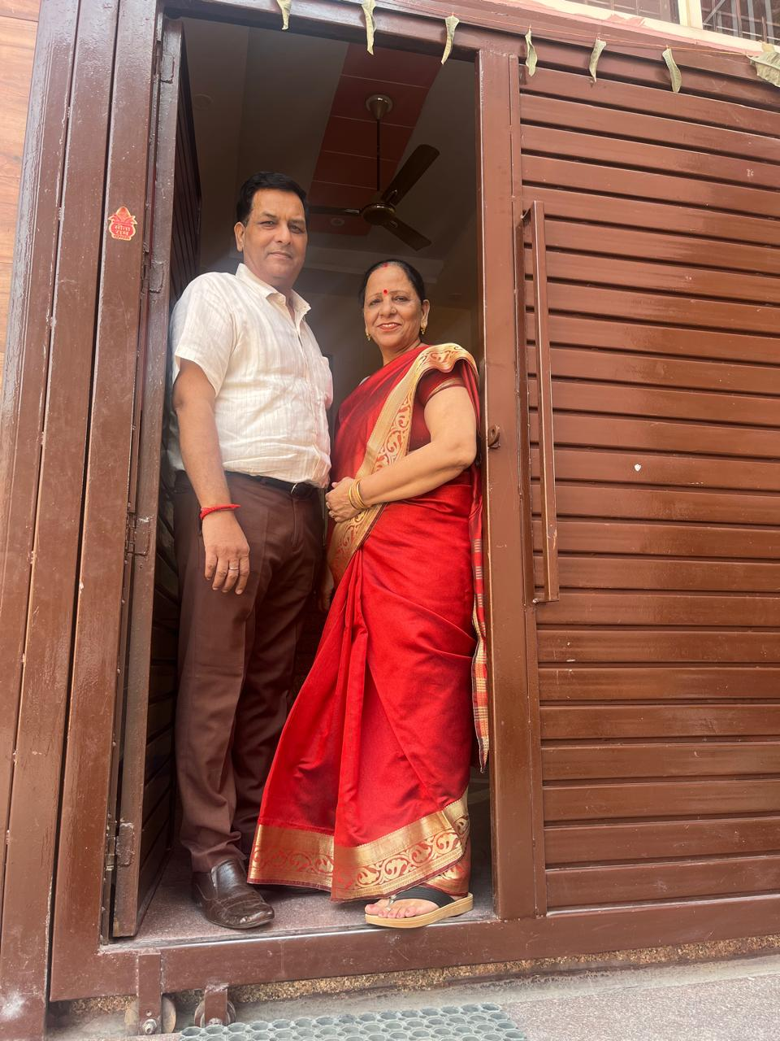
OUR ROOTS

Slide 8
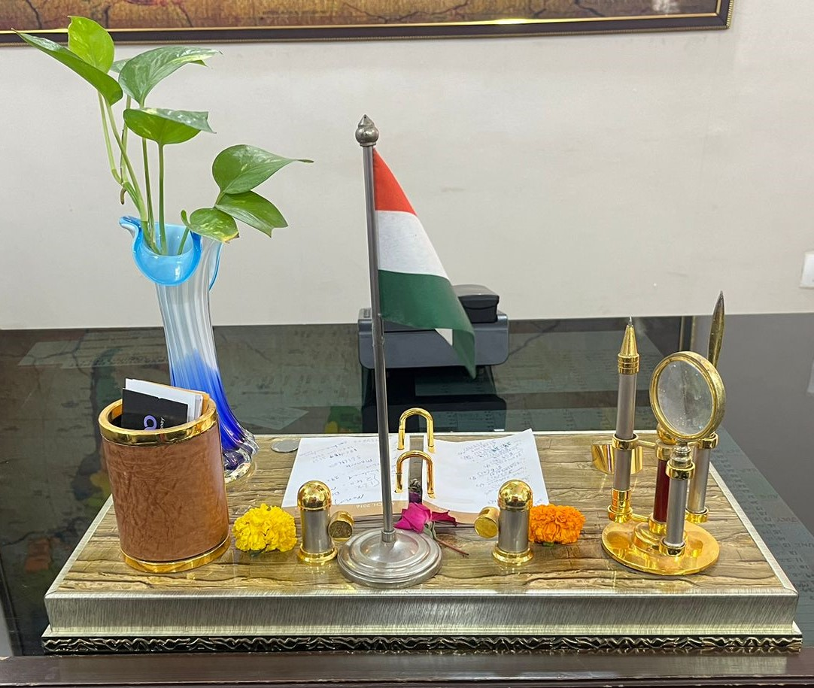
“WORDS FROM THE PRINCIPAL’S DESK”
शिक्षा का उद्देश्य केवल ज्ञान अर्जित करना ही नहीं,बल्कि एक बेहतर इंसान बनना भी है │

Slide 9
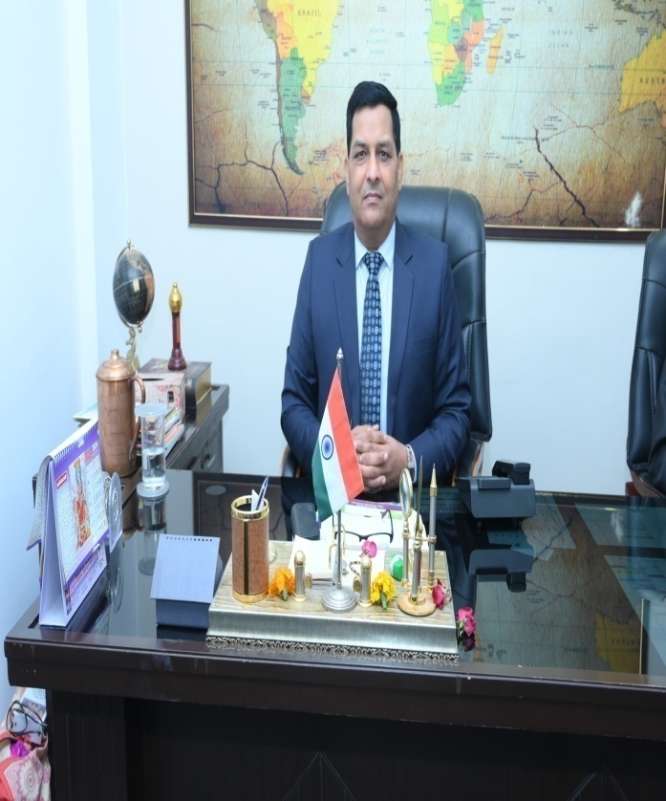
PRINCIPAL
MR. ARUN ATRI

Slide 10
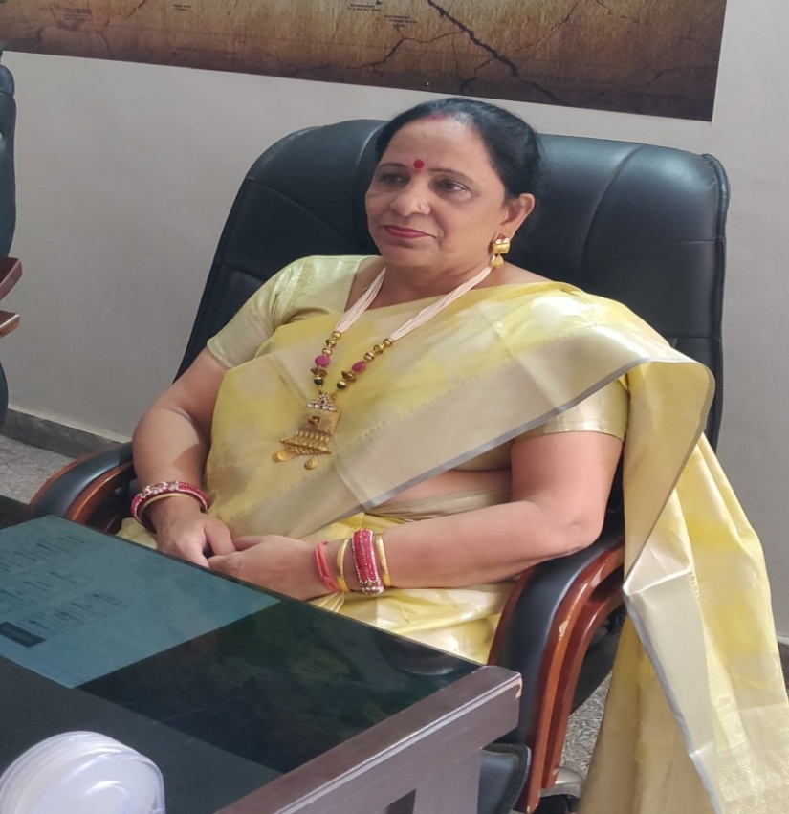
VICE PRINCIPAL
MRS. MANJU ATRI

Slide 11
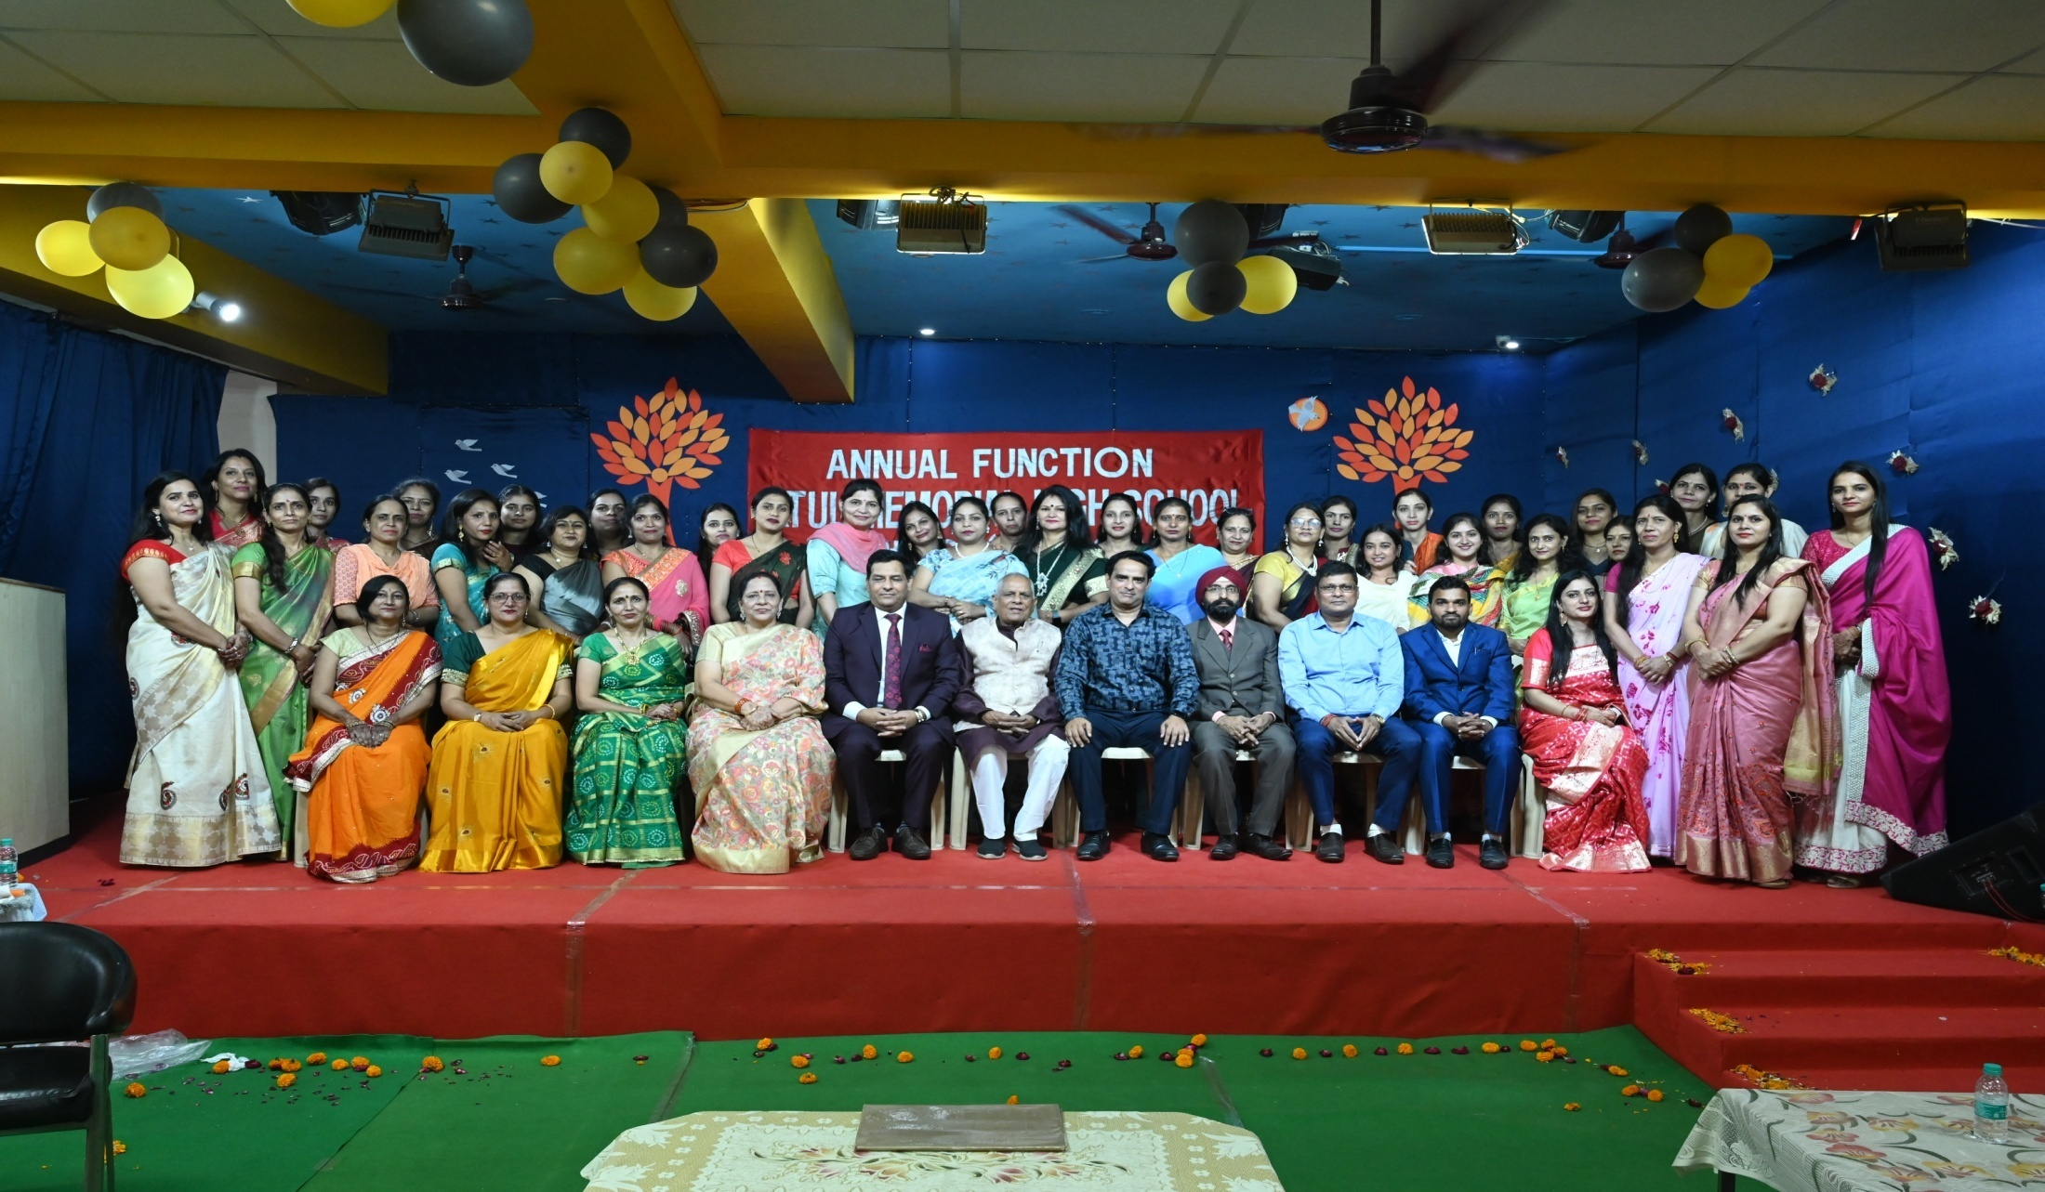
OUR EDUCATORS

Slide 12
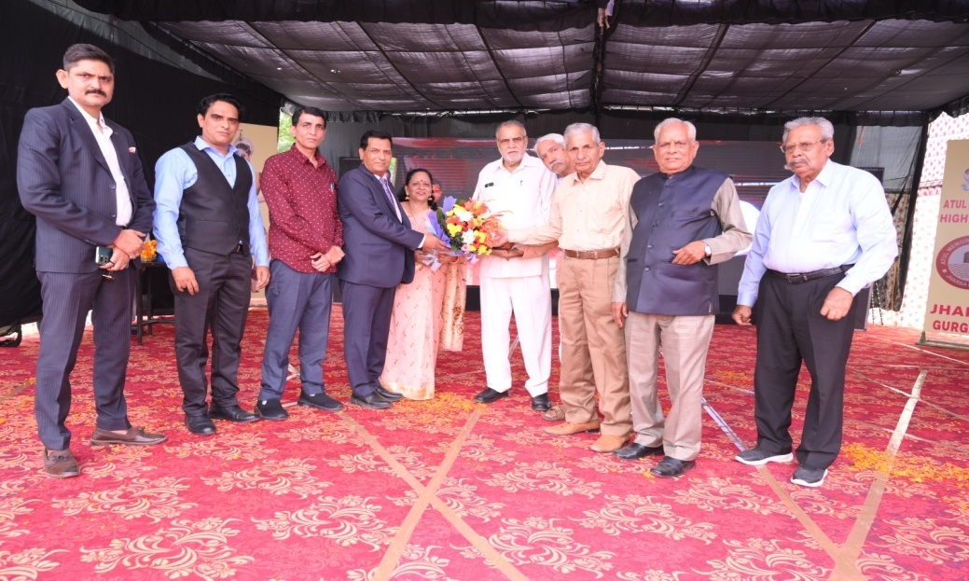
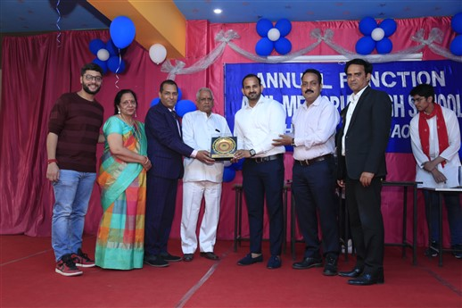
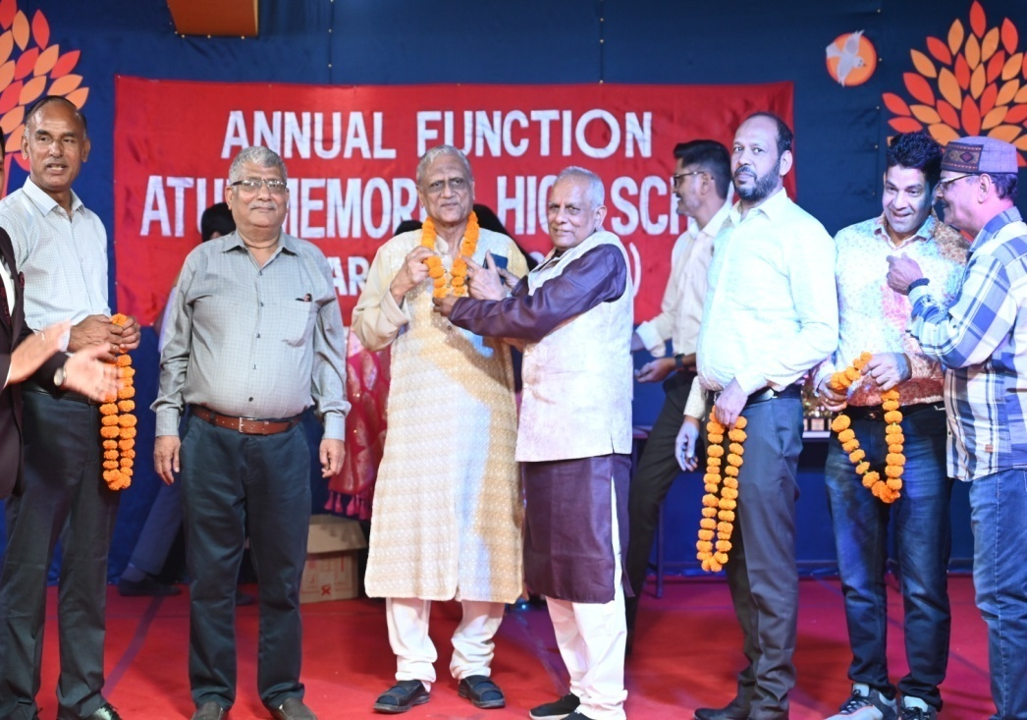
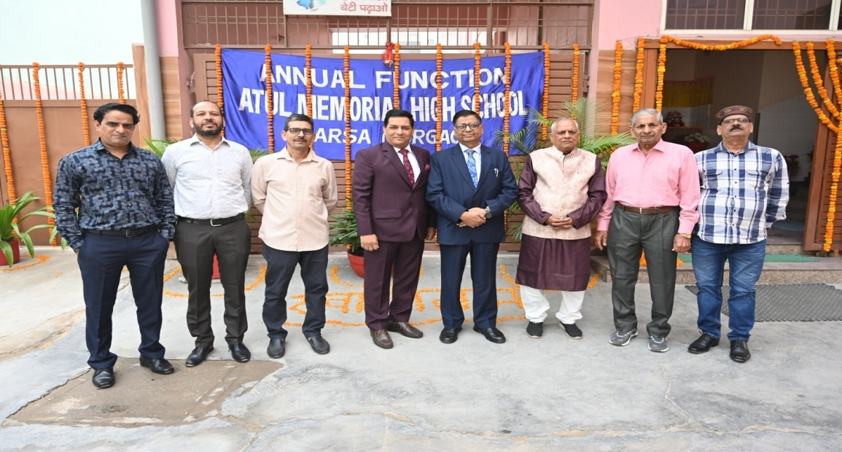
DIGNITARIES WHO VISITED US:

Slide 13
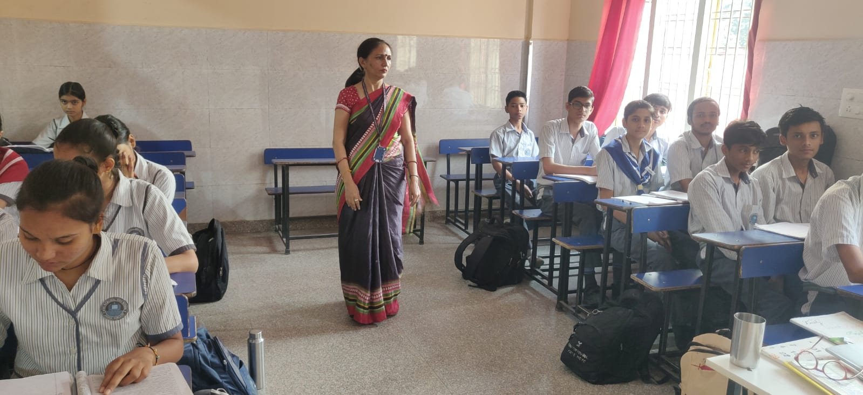
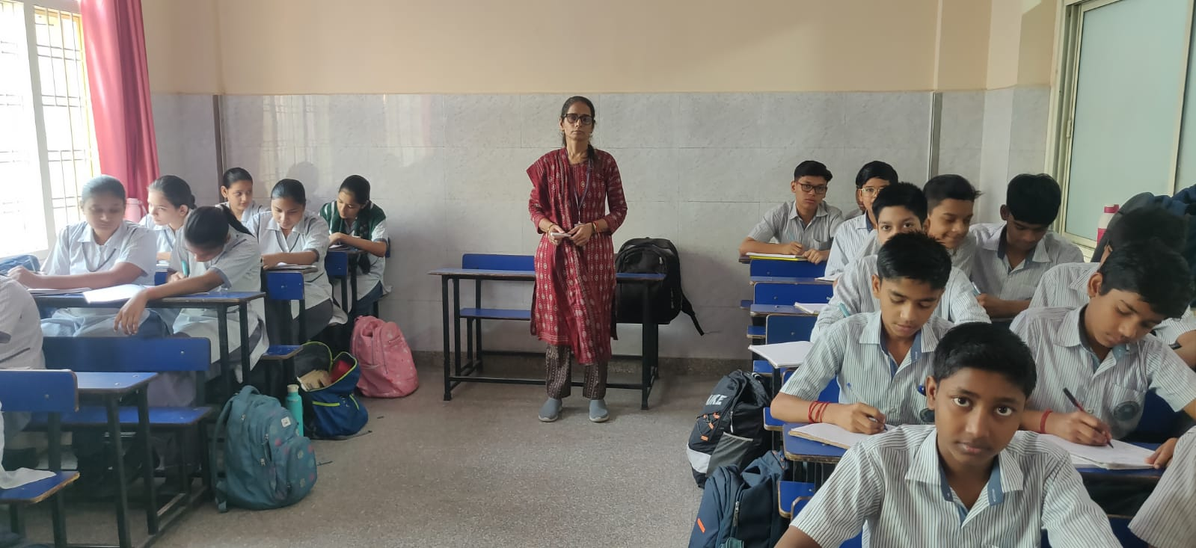
CLASSROOMS

Slide 14
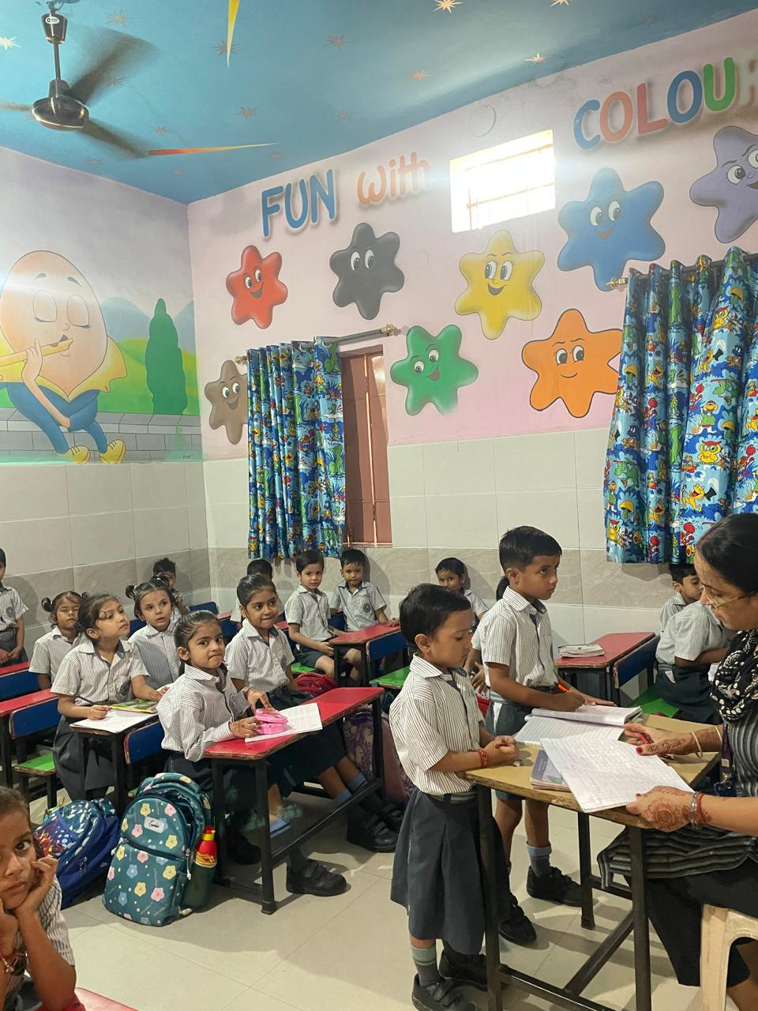
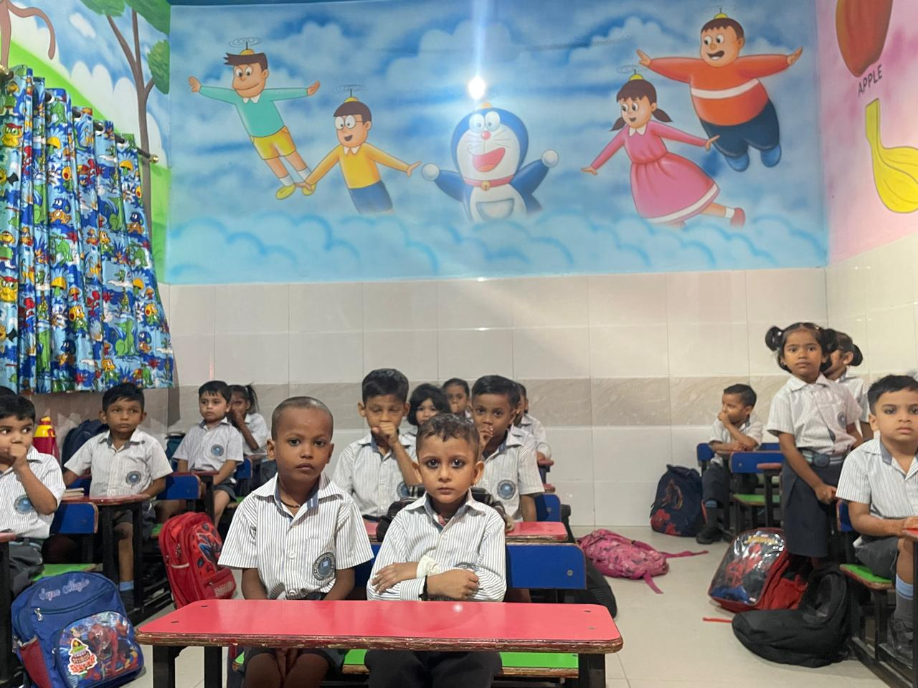
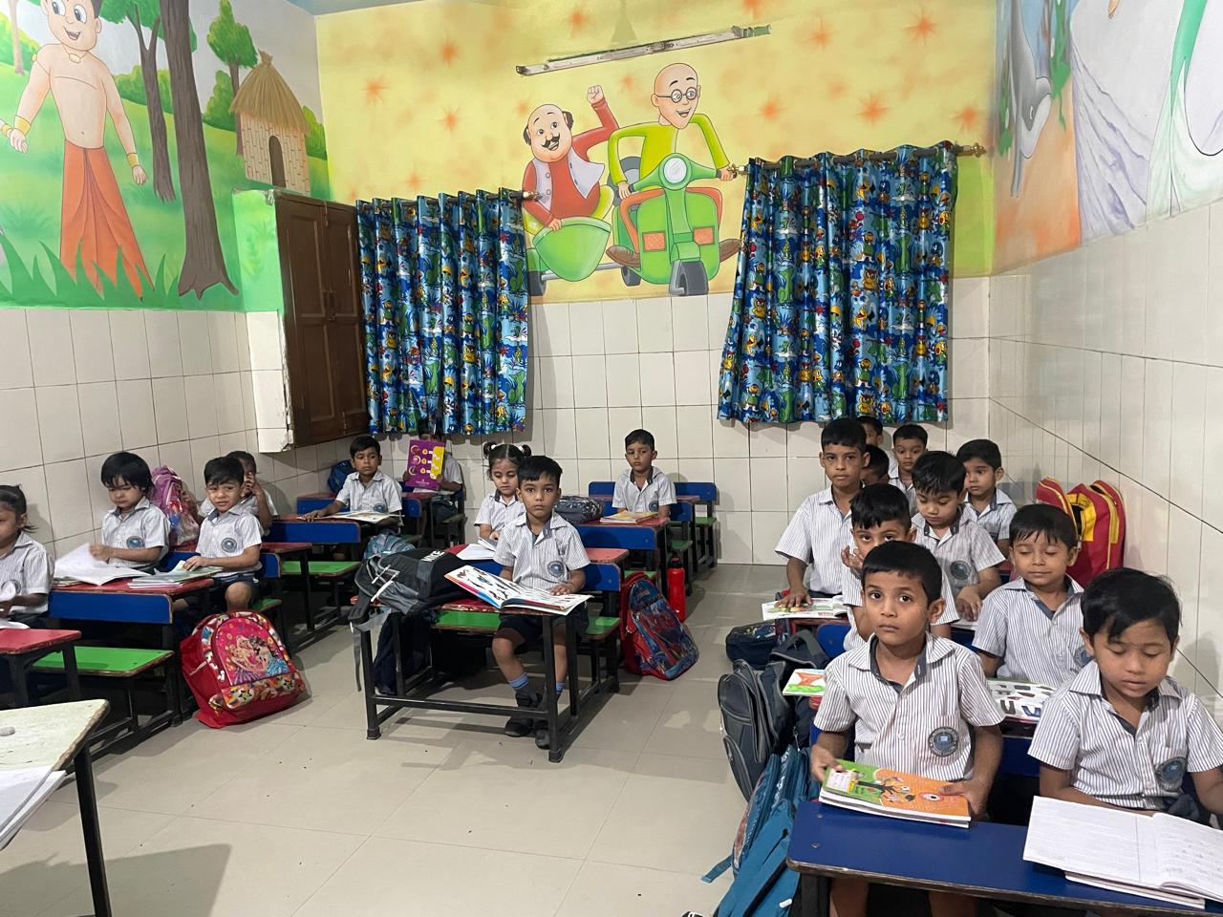
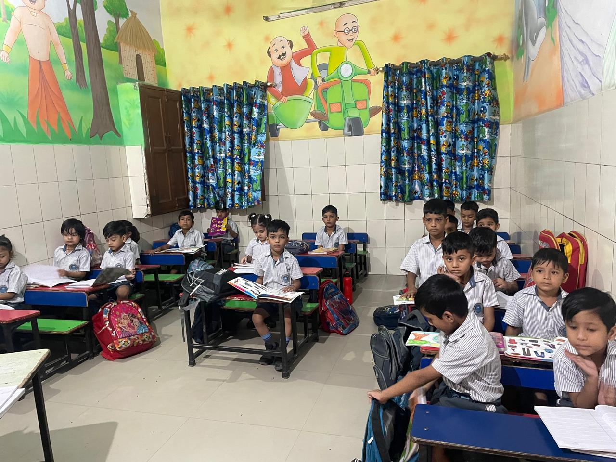
CLASSROOMS

Slide 15
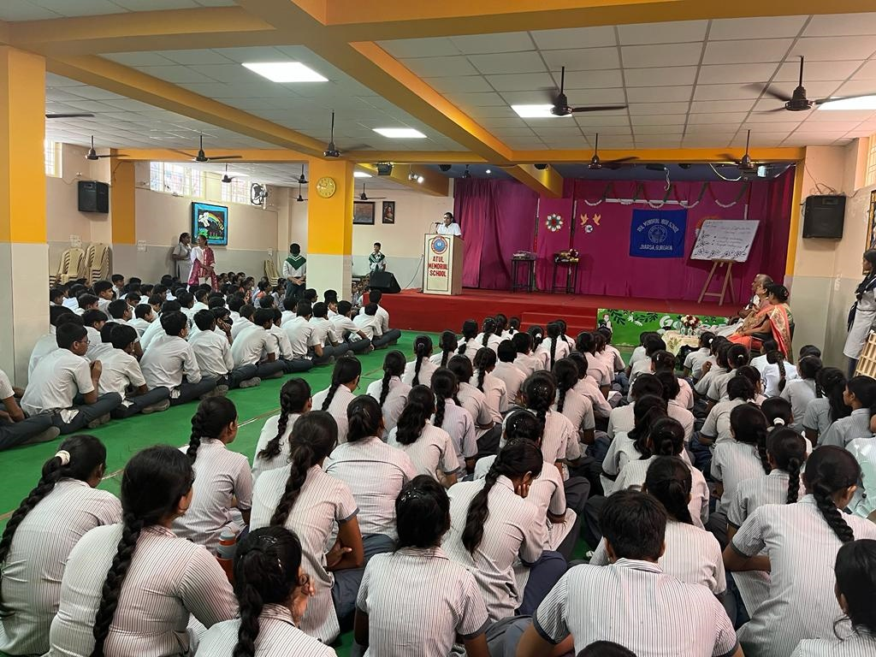
AUDITORIUM

Slide 16
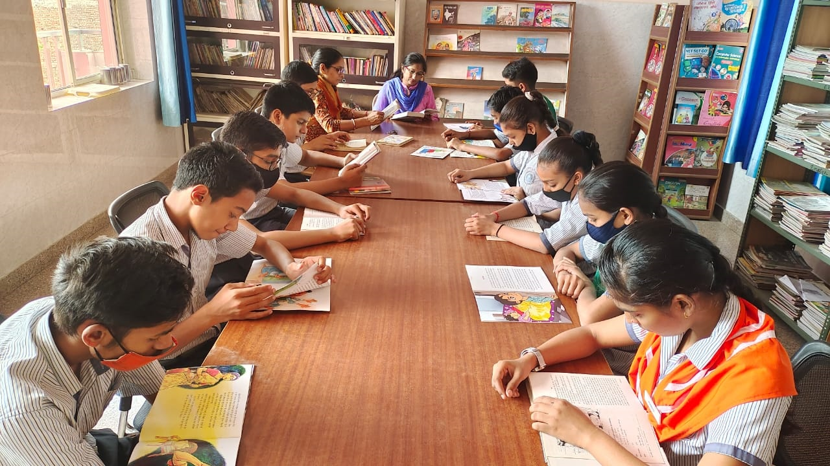
It’s Reading Time

Slide 17
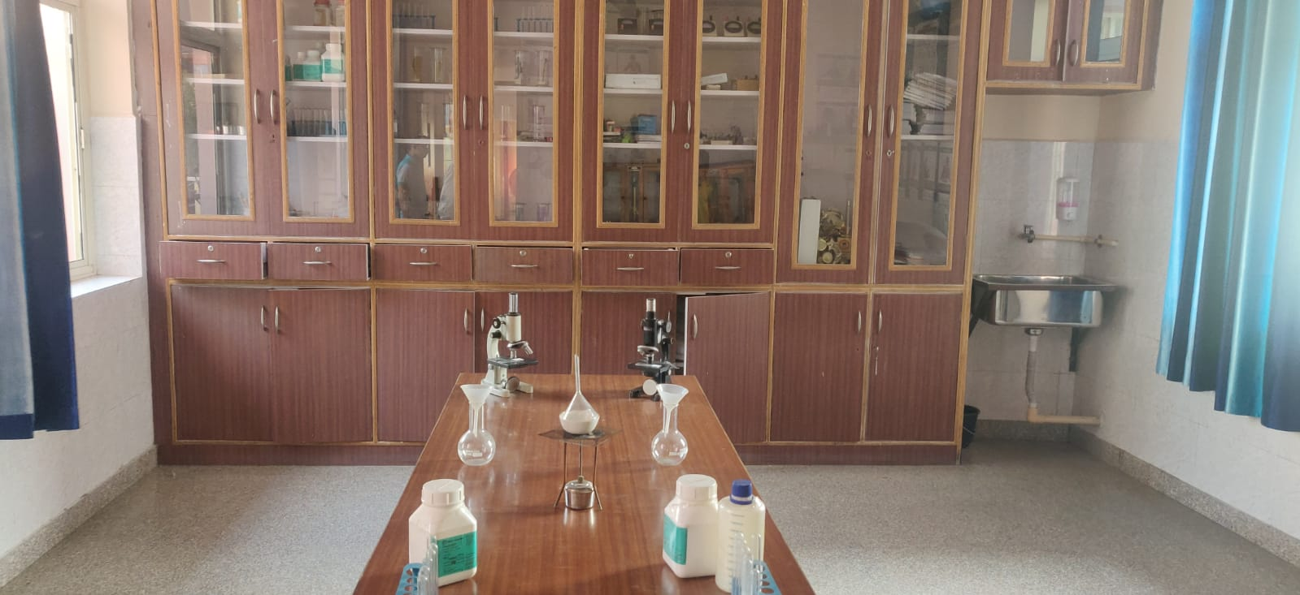
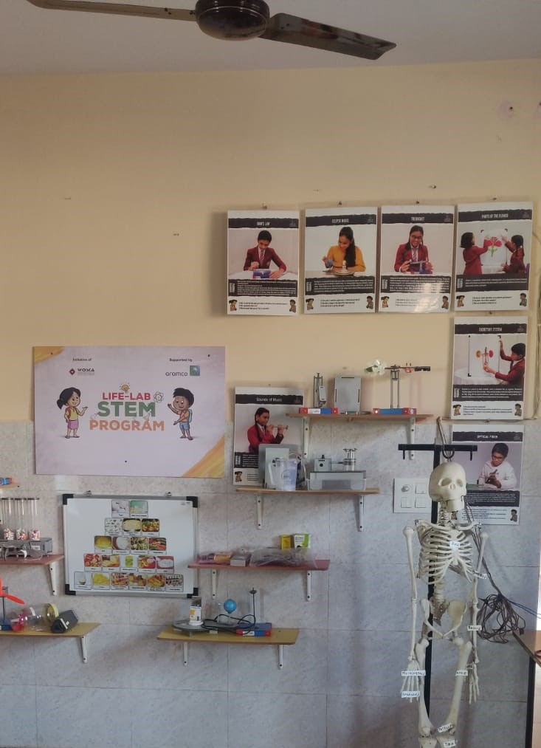
SCIENCE LAB

Slide 18
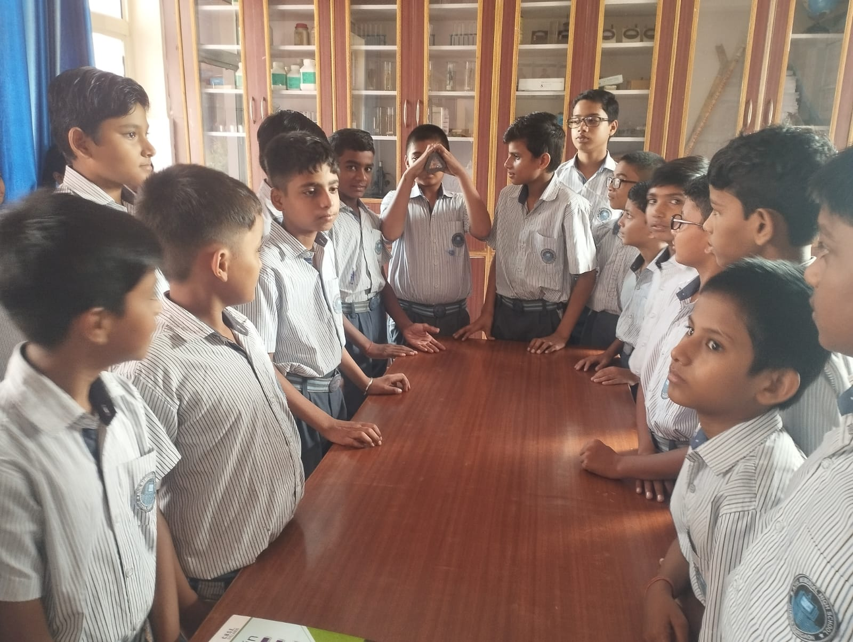
EXPERIMENT TIME

Slide 19
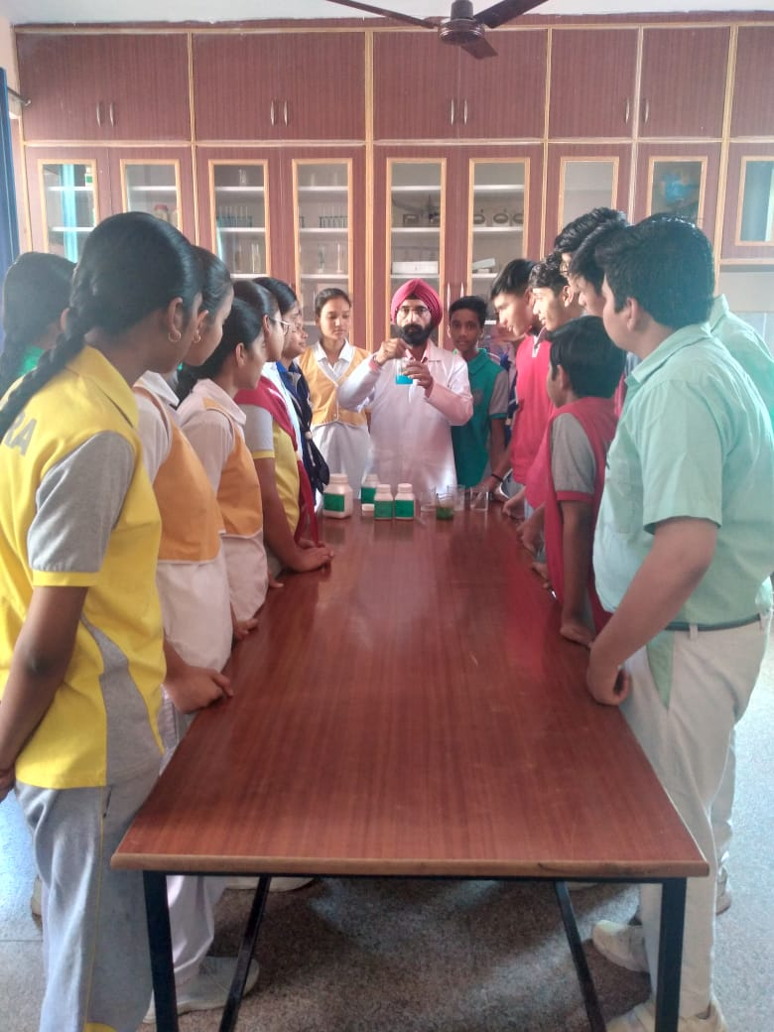
It’s Laboratory Time

Slide 20
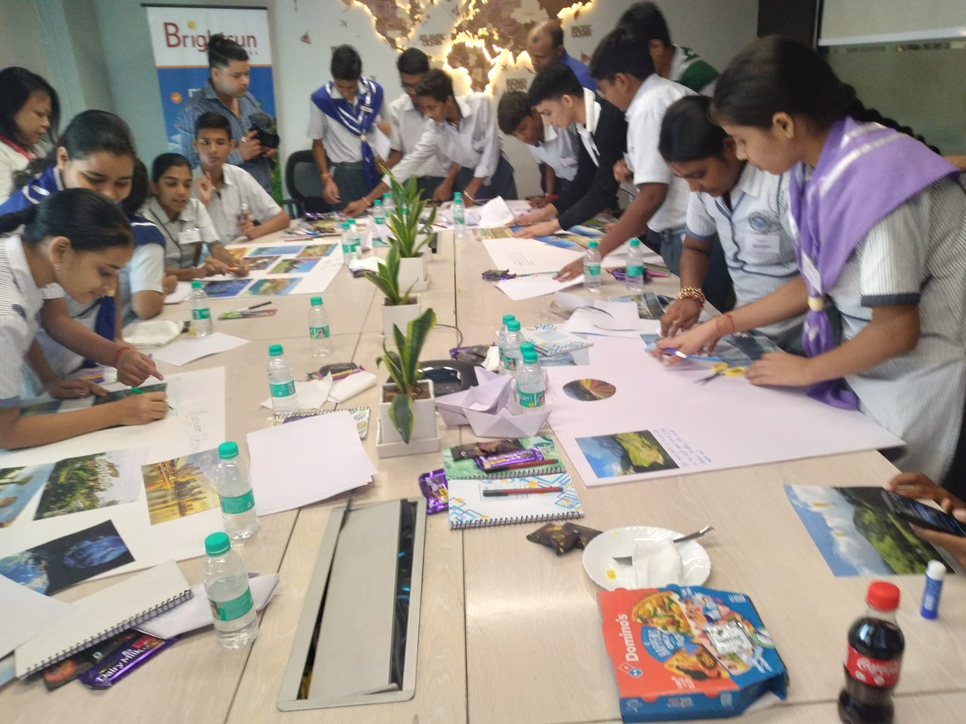
WORKSHOP AT SUNBRIGHT TRAVEL

Slide 21
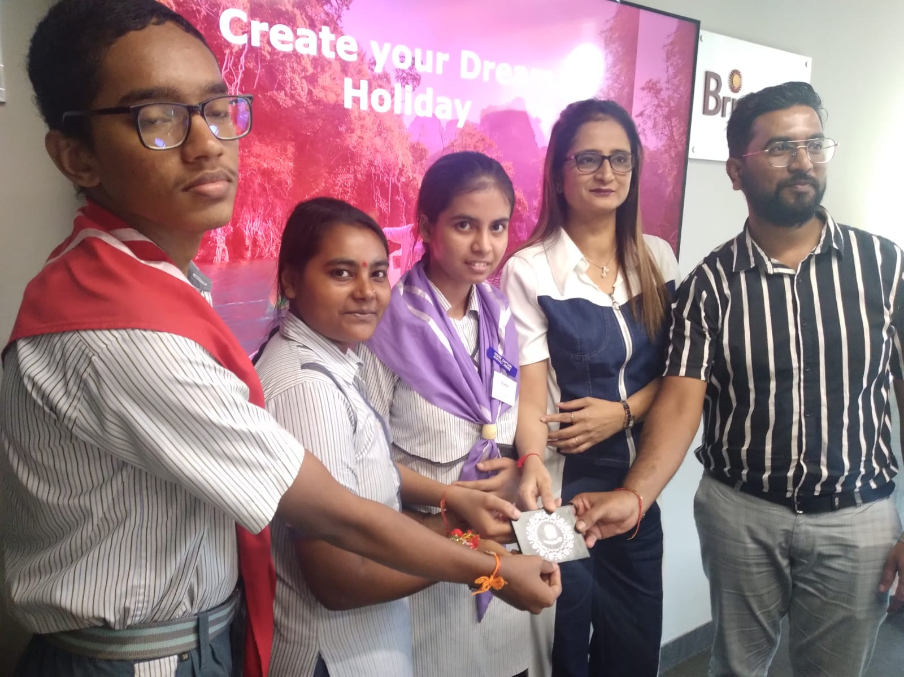
WORKSHOP AT SUNBRIGHT TRAVEL

Slide 22
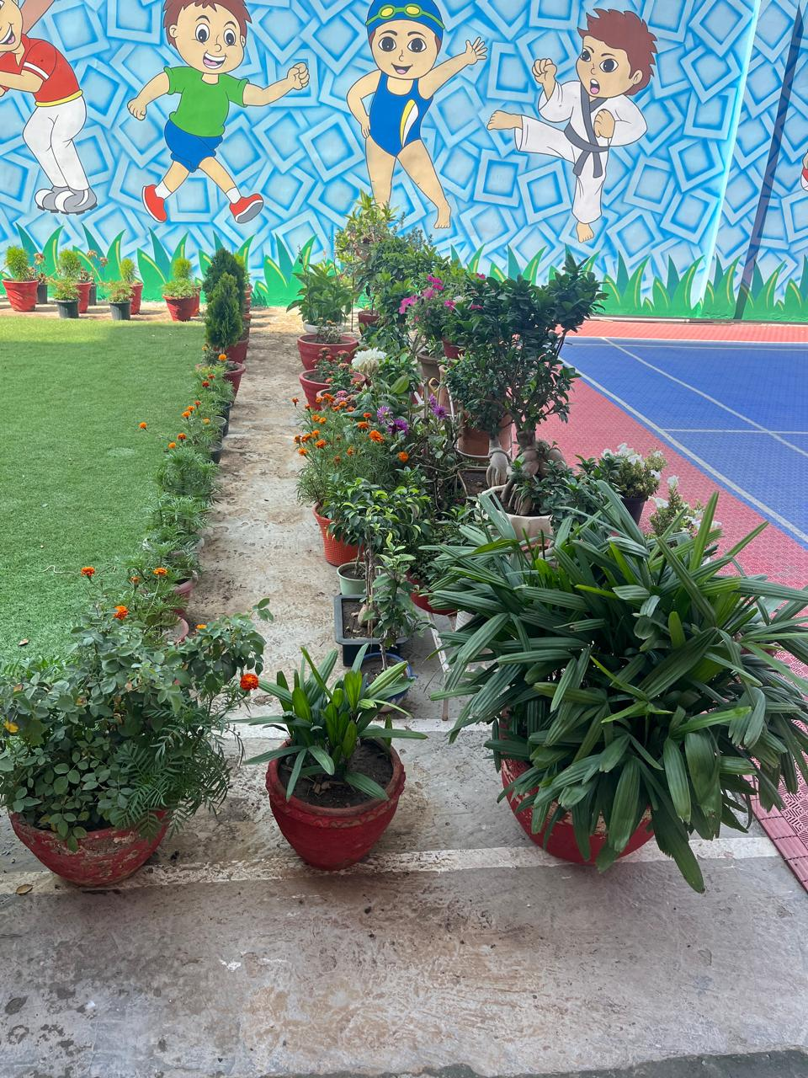
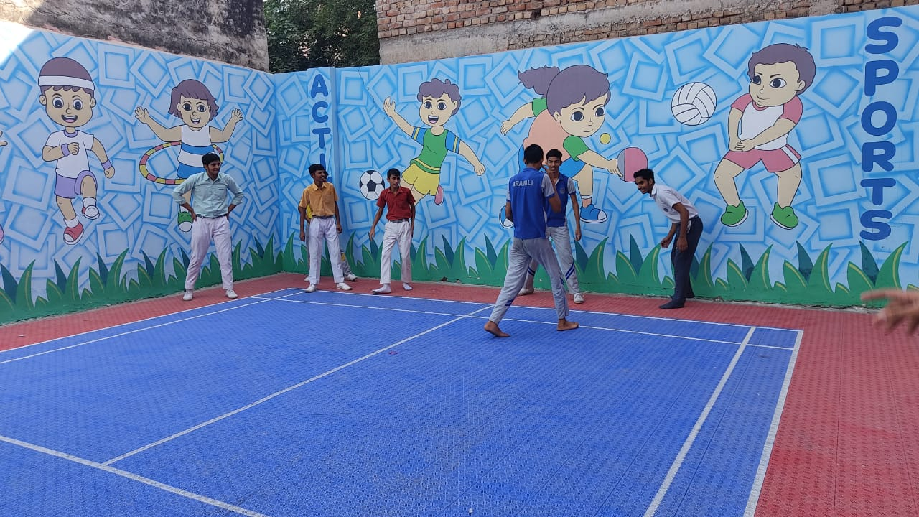
OUR PLAY AREA

Slide 23
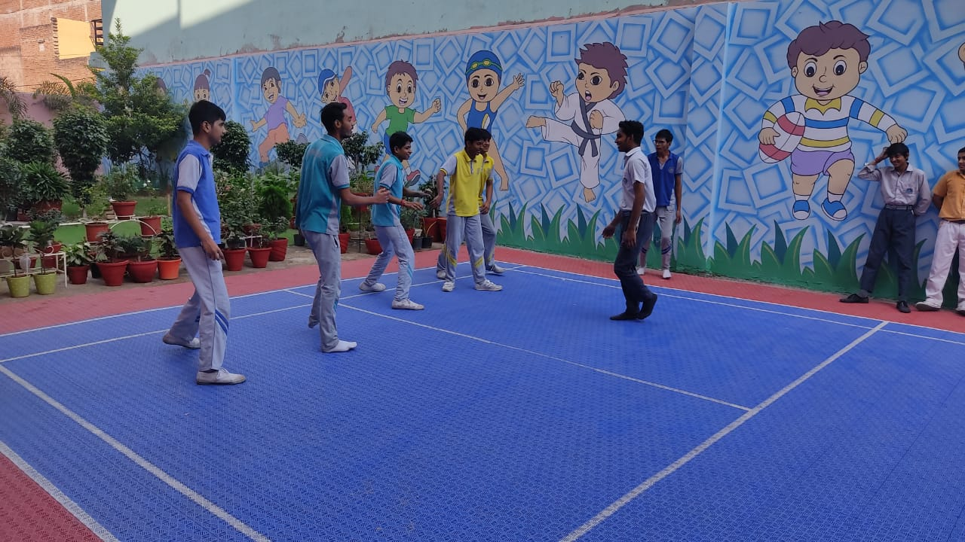
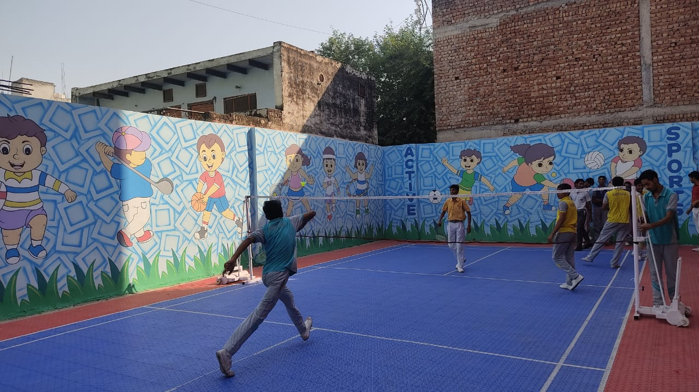
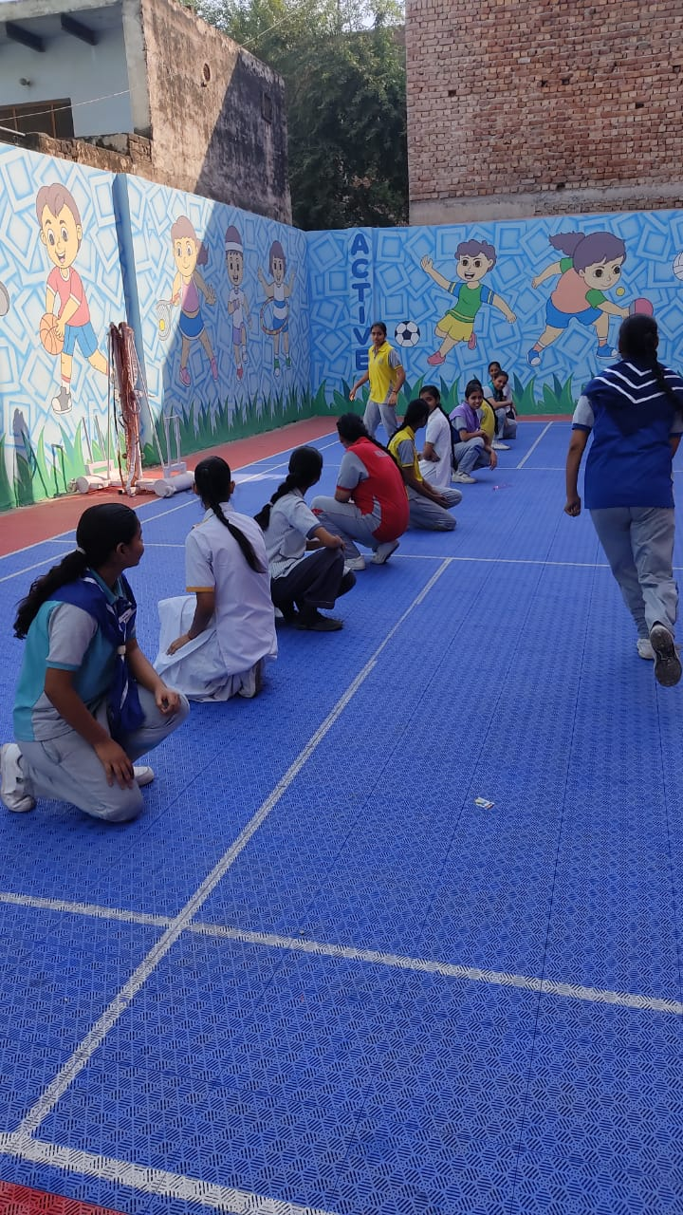
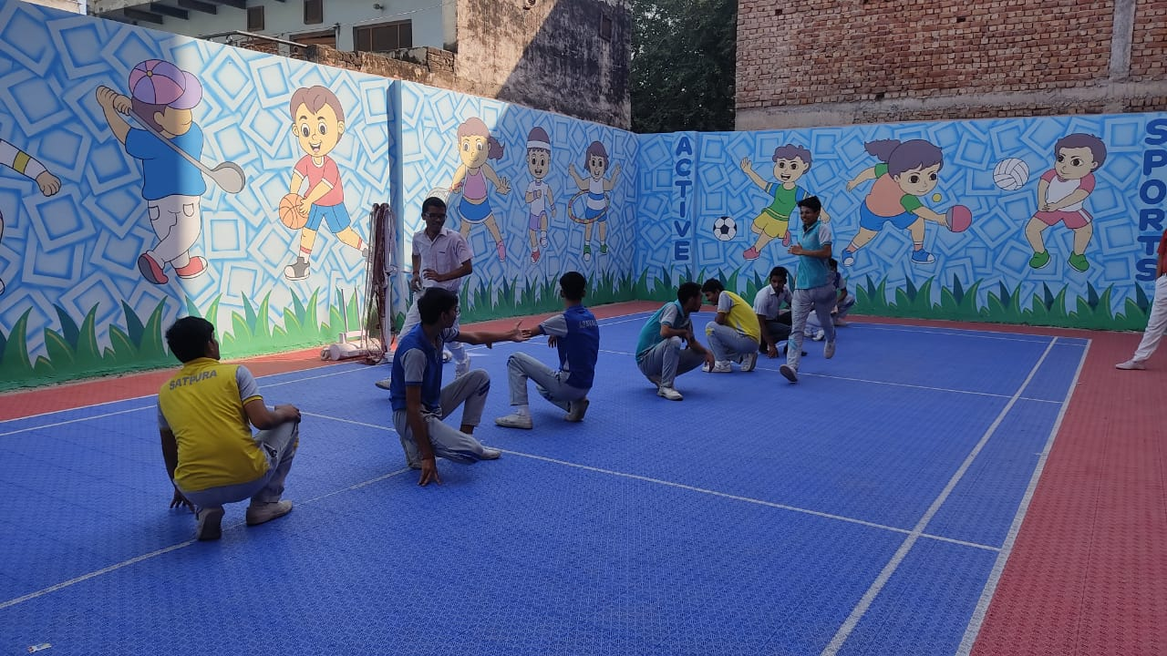
SPORTS ACTIVITY

Slide 24
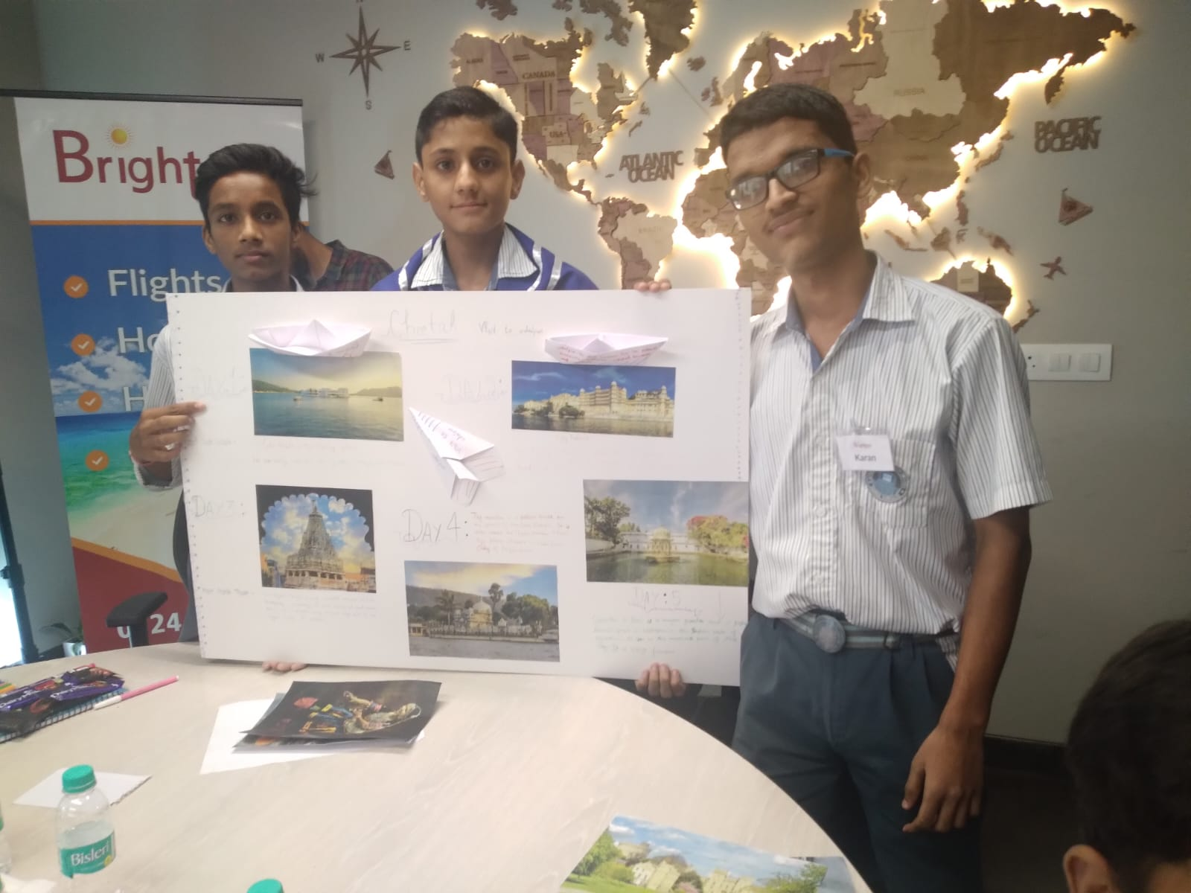
WORKSHOP AT SUNBRIGHT TRAVEL

Slide 25
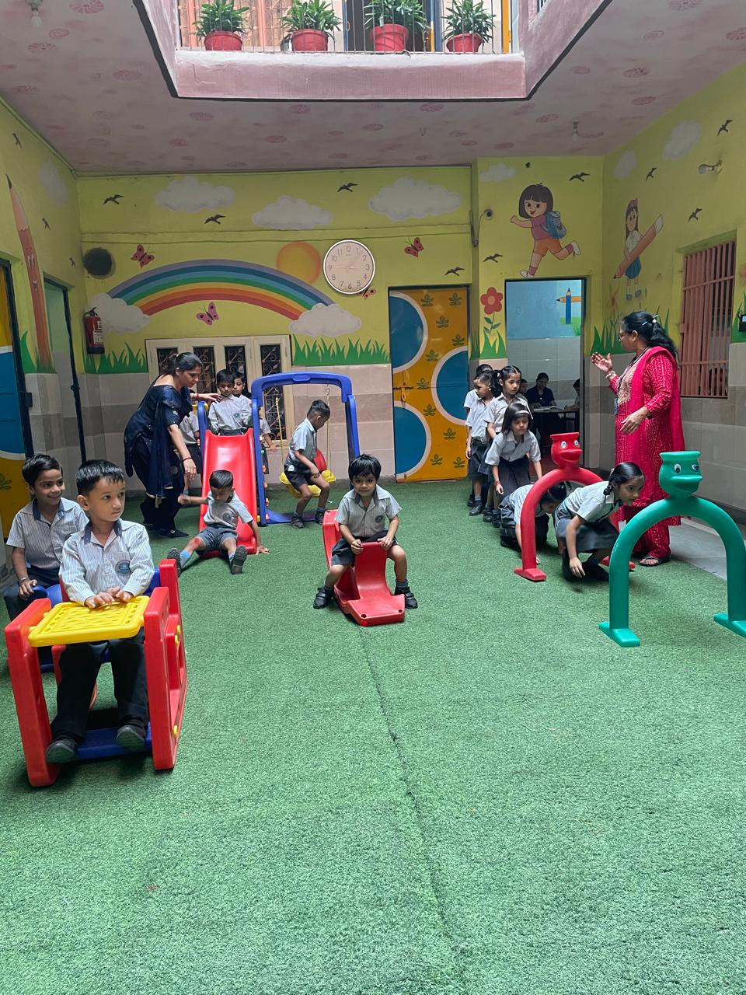
PLAYING TIME FOR TINY TOTS

Slide 26
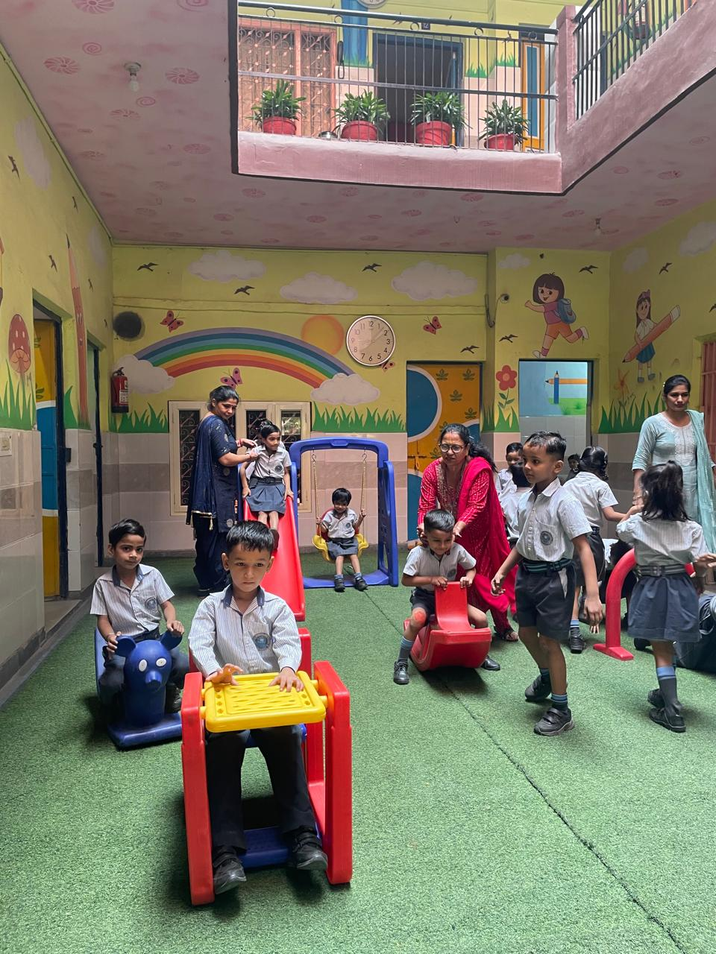
PLAYING TIME FOR TINY TOTS
NG TIME

Slide 27
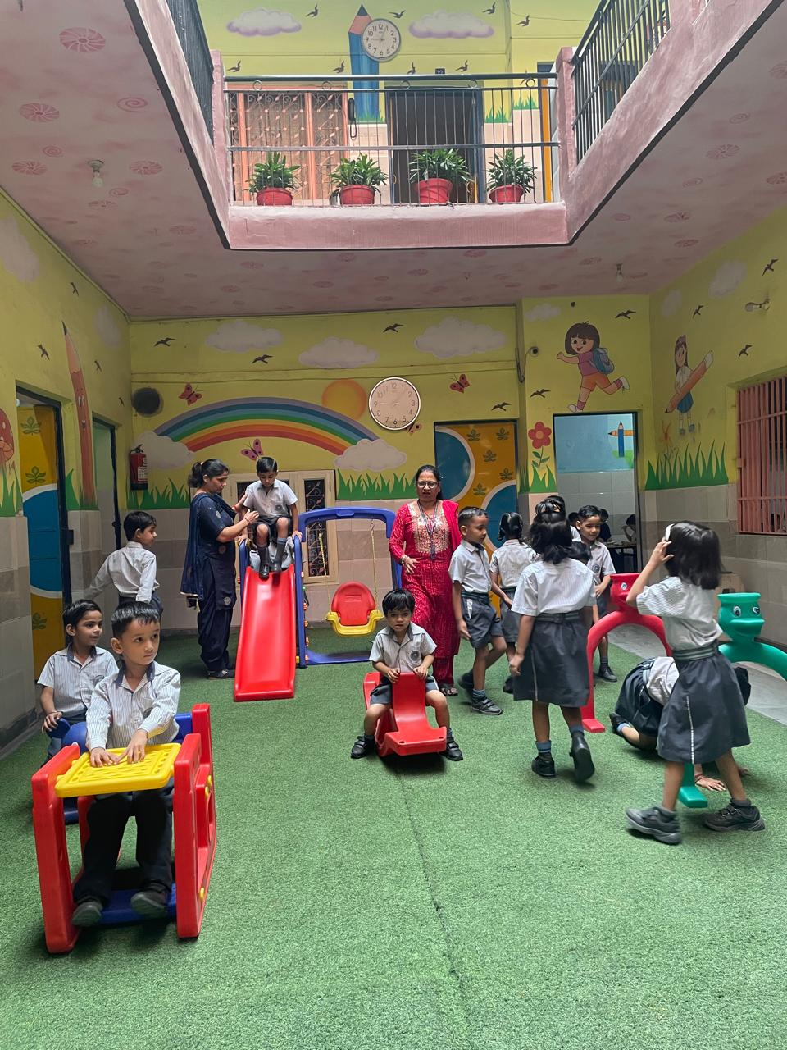
PLAYING TIME FOR TINY TOTS

Slide 28
PLAYING TIME FOR TINY TOTS

Slide 29
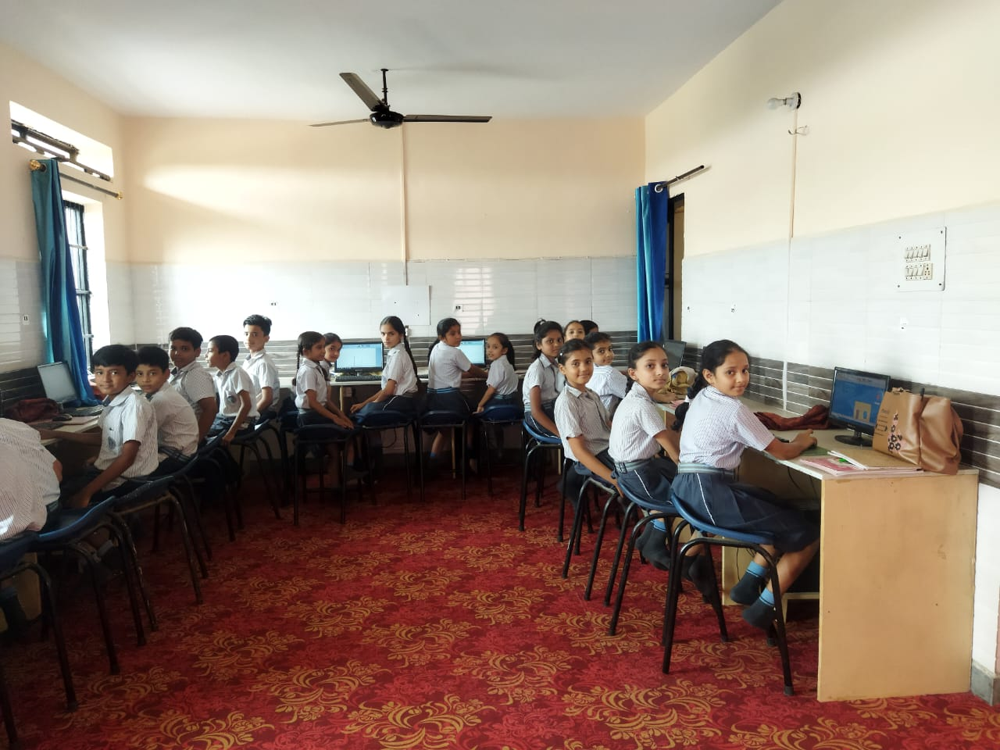
COMPUTER LAB

Slide 30
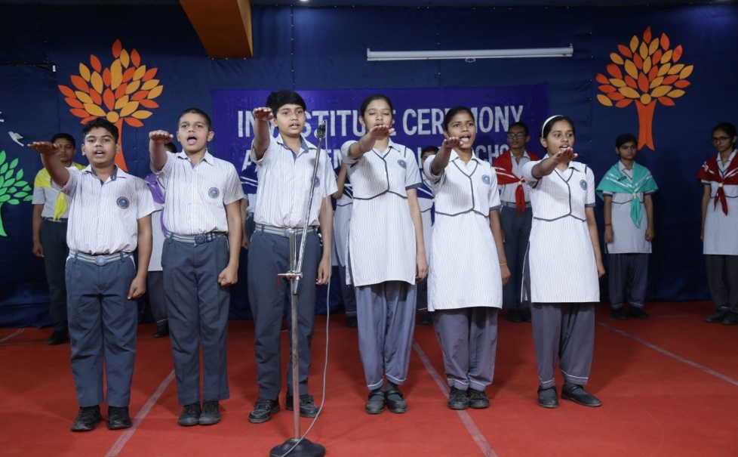
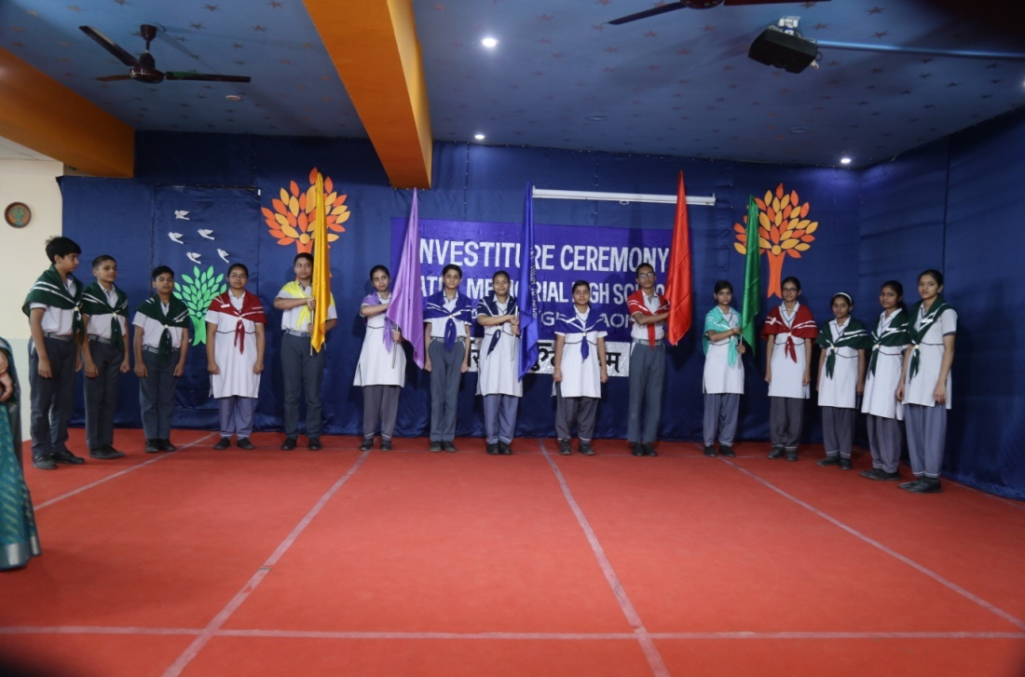
INVESTITURE CEREMONY

Slide 31
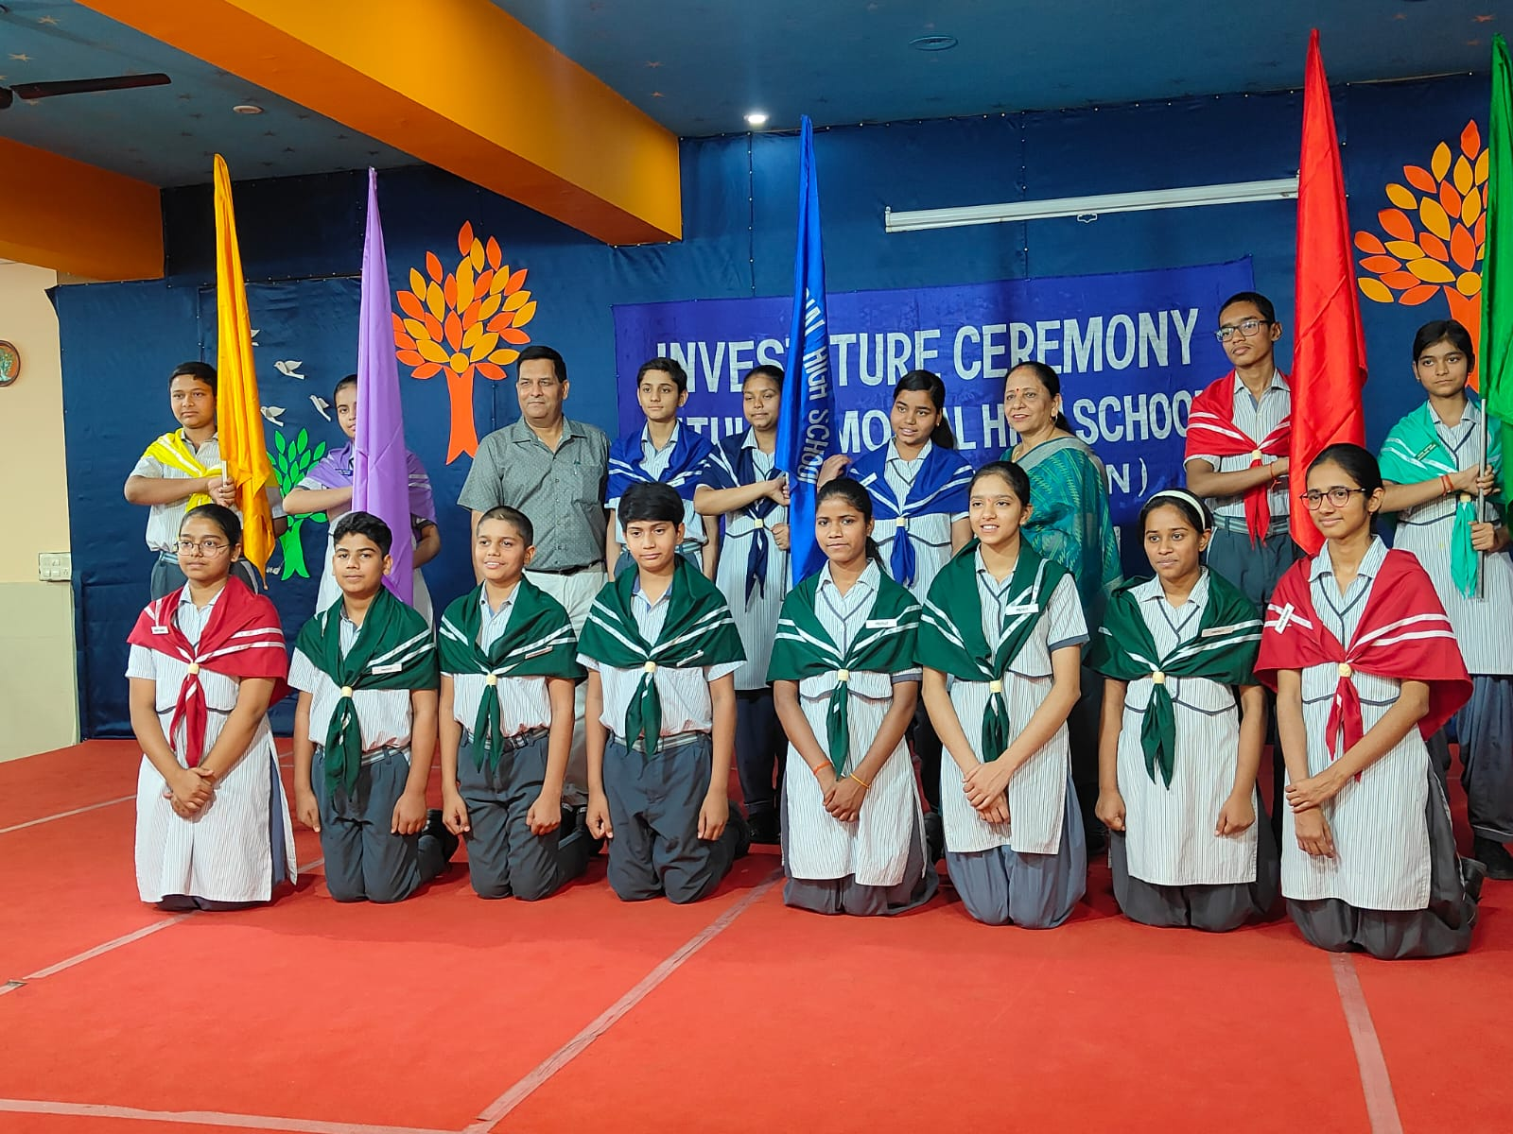
INVESTITURE CEREMONY

Slide 32
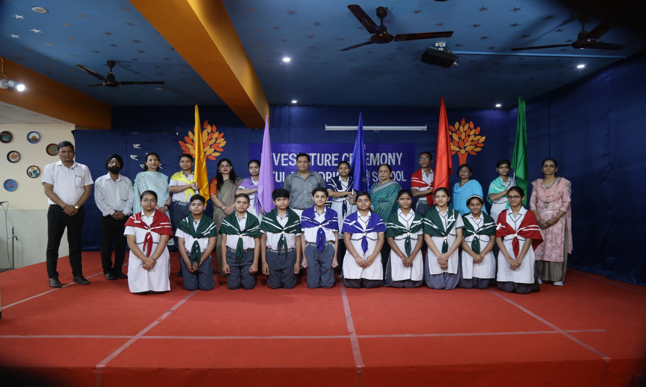
INVESTITURE CEREMONY

Slide 33
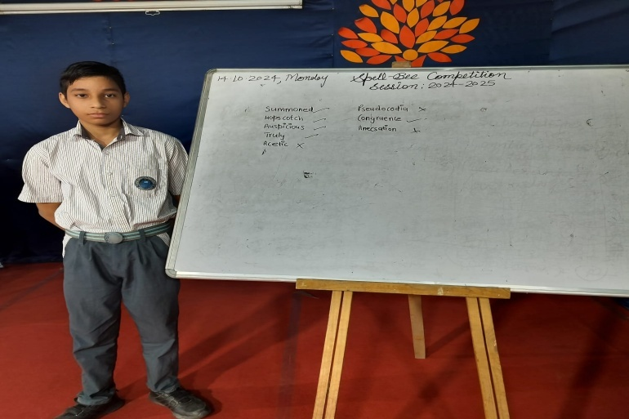
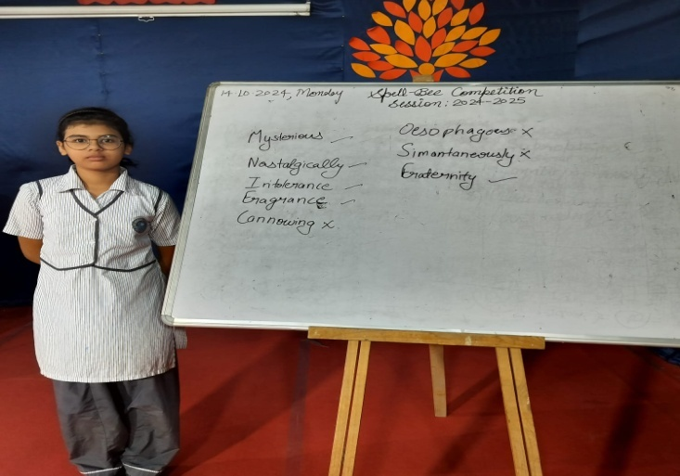
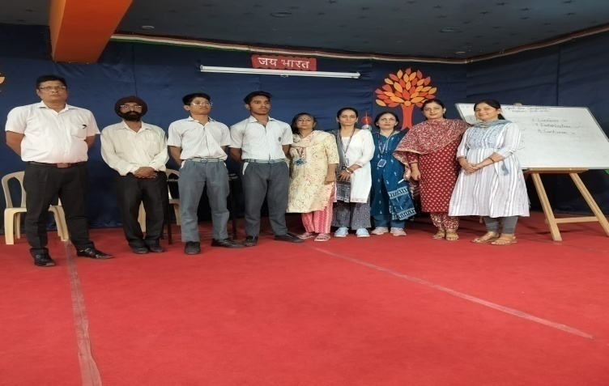
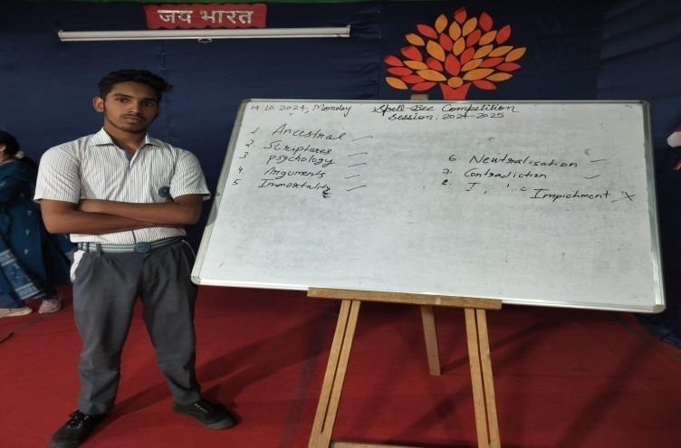
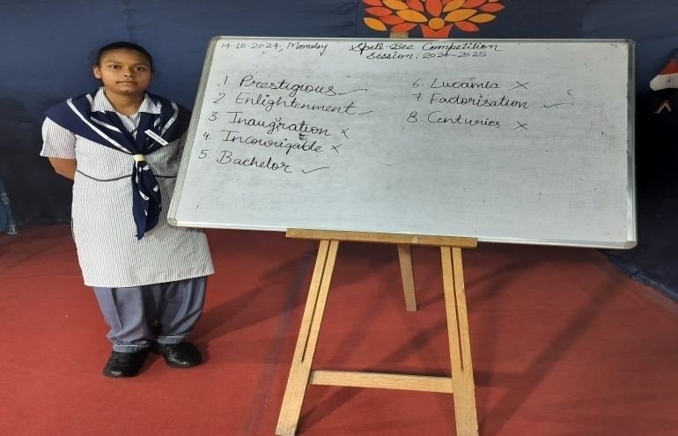
SPELL BEE COMPETITION

Slide 34
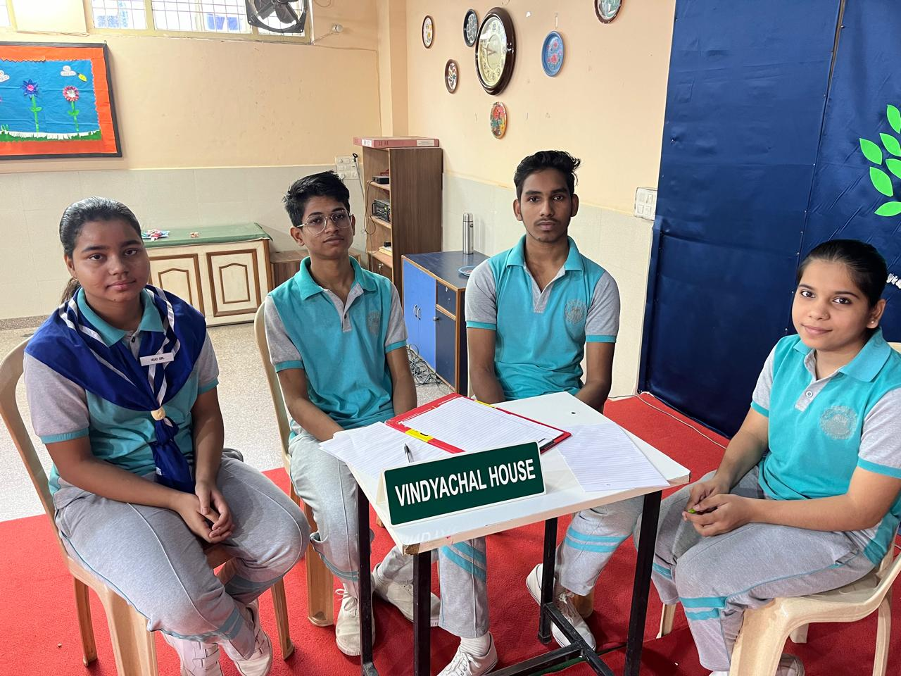
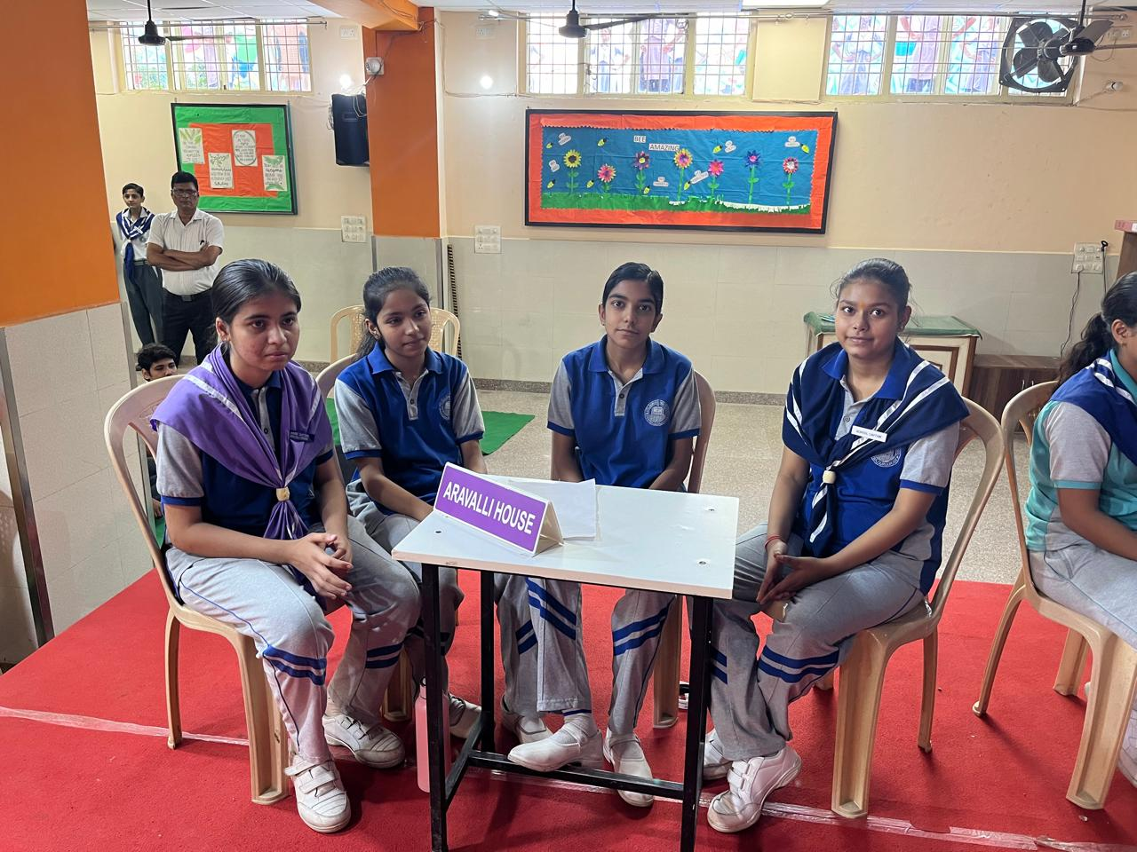


INTER-HOUSE QUIZ COMPETITION

Slide 35

INTER-HOUSE QUIZ WINNER COMPETITION

Slide 36


INTER – HOUSE DEBATE COMPETITION WINNERS

Slide 37




CARROM COMPETITION

Slide 38



YOGA DAY

Slide 39

ECO GREEN BY MCG

Slide 40




ANNUAL PRIZE DISTRIBUTION (2022-23)

Slide 41



SCIENCE EXHIBITION

Slide 42

SCIENCE EXHIBITION

Slide 43

WINNER OF POETRY RECITATION COMPETITION

Slide 44




CULTURAL ACTIVITY (REGIONAL DANCE)

Slide 45



TRIP TO LOHA GARH

Slide 46

TEACHER’S DAY

Slide 47



INDEPENDENCE DAY CELEBRATION

Slide 48




JANAMASTAMI CELEBRATION

Slide 49

INDEPENDENCE DAY CELEBRATION

Slide 50

INDEPENDENCE DAY CELEBRATION

Slide 51


NAVRATRI CELEBRATION

Slide 52

THE MAGIC SHOW

Slide 53

SEMINAR BY GPT GROUP

Slide 54

Its time to talk about
( GOOD TOUCH BAD TOUCH )

Slide 55


MEDICAL CAMP

Slide 56

PARENTS ORIENTATION DAY

Slide 57

OLD MEMORIES

Slide 58


OUR PEARLS
2023-24

Slide 59

OUR PEARLS (2023-24)
TOPPER OF AHMS
AORANJEB AALAM 96.8%

Slide 60



OUR PEARLS (2023-24)
STUDENTS GOT 2ND RANK
RIYA KUMARI 96.4%
HIMANSHU 96.4%
SAHIL SINGH 96.4%

Slide 61






OUR PEARLS (2023-24)
ADITYA KUMAR 96%
AALMIN 95%
AKNIT SATAPATHY 95.6%
JASMEET 94%
AASHISH 93.8%
SUSHMA SAHOO 94.8%

Slide 62






OUR PEARLS (2023-24)
ANKIT PANDEY 93.4%
SHIVAM 92.6%
ANASHIKA RAI 92.6%
NANDANI 92.3%
RIYA THAKRAN 91.8%
K DEEPSHIKHA 91.6%

Slide 63






OUR PEARLS (2023-24)
GAGAN BHARDWAJ 91.4%
BHAWANA 91.2%
DEEPAK KUMAR 91.2%
JATIN KUMAR 90.4%
LAKSHAY 90.2%
SONAL 90.2%

Slide 64






OUR PEARLS (2023-24)
ABHISKEK 89.8%
SURAJ AHIRWAL 89.8%
RITIK 89.8%
ANUSHKA GUPTA 89%
SIBGATULLAH 89%
SHAKSHI 89%

Slide 65






OUR PEARLS (2023-24)
DRISHTI THAKRAN 89%
HARSH PRABHA 88.4%
PAWAN KUMAR RAI 88.4%
VINAYAK PANDEY 88.4%
VANSHIKA 87.8%
PAWAN SUNAR 87.4%

Slide 66






OUR PEARLS (2023-24)
SAKSHAM 86.6%
MANJEET 86.2%
LALIT 86%
SHWETA SAHOO 85.4%
KOMAL 85.2%
PIYUSH BHARDWAJ 84.6%

Slide 67






OUR PEARLS (2023-24)
ADITI 84.6
JATIN BHADHOTIYA 83.4
MAMATA 83.2
HARIKESH 83.2
JATIN SINGH 83
LAXMI 81.8

Slide 68




OUR PEARLS (2023-24)
ANKIT BHAGAT 81.8%
ASHWANI CHOUHAN 80.8%
KANISHKA 80%
KRISHNA PRAJAPATI 80%

Slide 69

OLD MEMORY OF OUR PEARLS (2023-24)

Slide 70

OLD MEMORY OF OUR PEARLS (2023-24)

Slide 71

OLD MEMORY OF OUR PEARLS (2023-24)

Slide 72

OLD MEMORY OF OUR PEARLS (2023-24)

